Slide 1
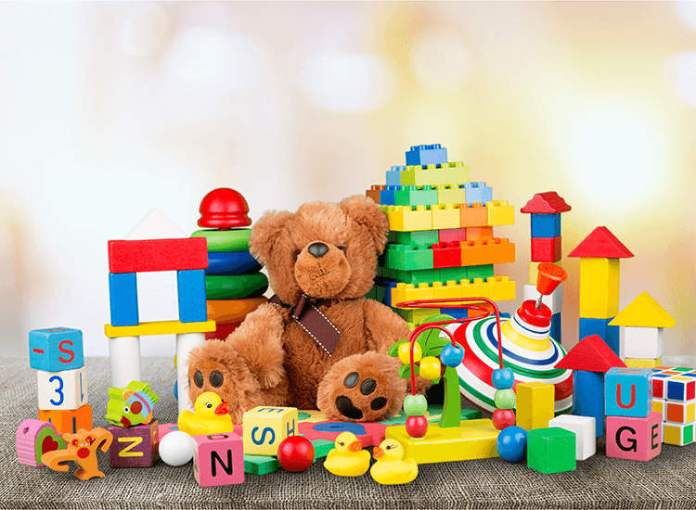
Тема уроку:
“Мої іграшки”
English with Smiling Sam
“My Toys”
Grade – 1
Teacher – Kochish Victoria

Slide 2

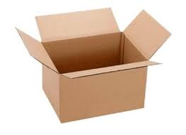
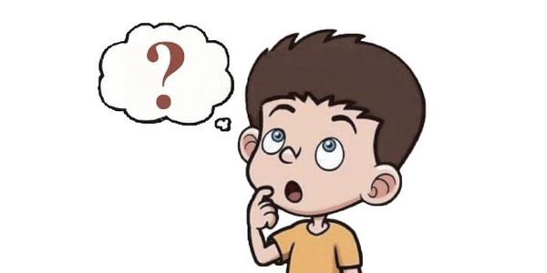
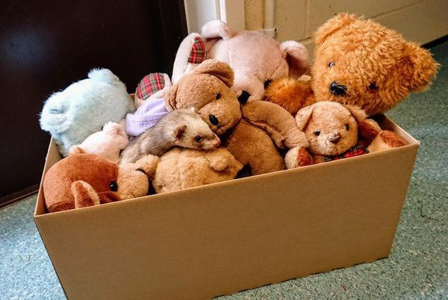
Hello, children!
Look
What is this?
It is a toy box.

Slide 3
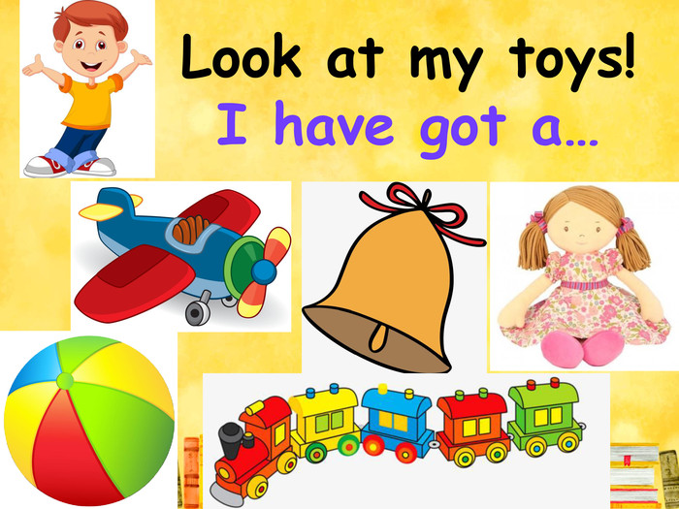
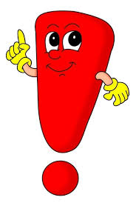

Slide 4
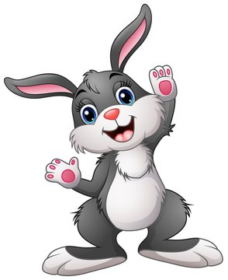

I have got
a bunny

Slide 5


I have got
a bell

Slide 6
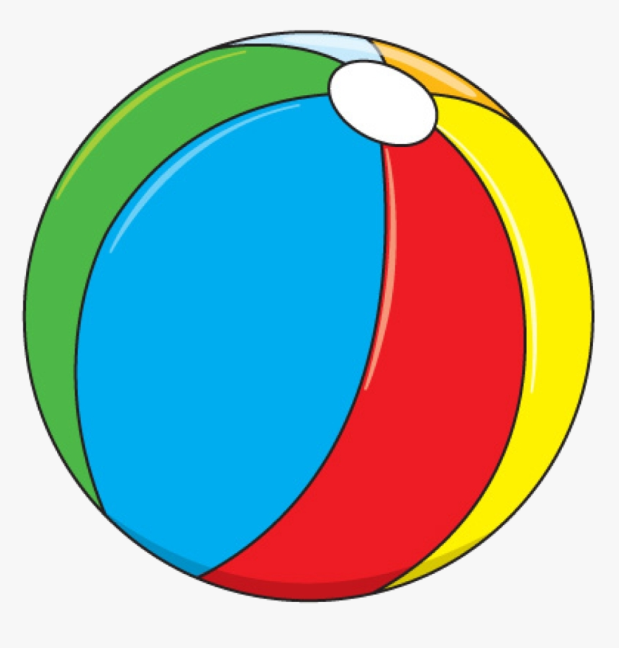

I have got
a ball

Slide 7


I have got
a bike

Slide 8
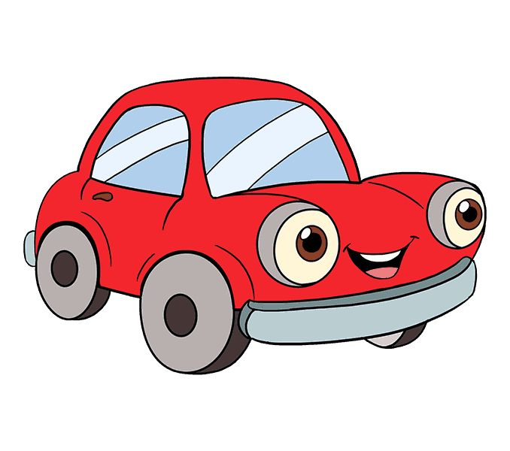

I have got
a car

Slide 9
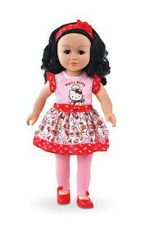
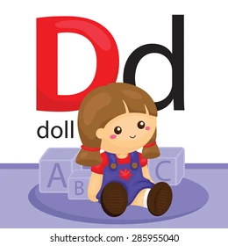
I have got
a doll

Slide 10

I have got
a train

Slide 11

I have got
a teddy bear

Slide 12
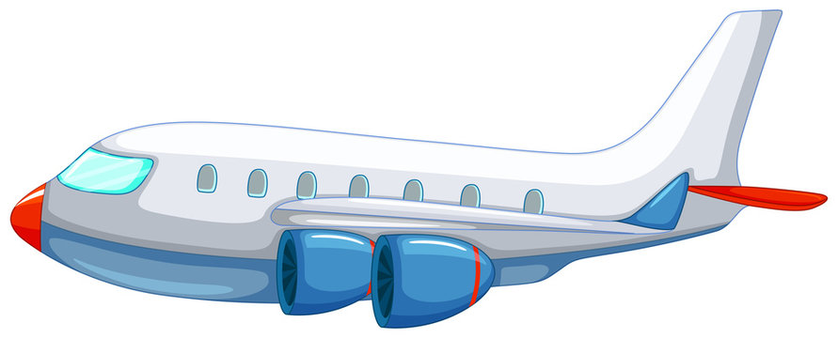
I have got
a plane

Slide 13
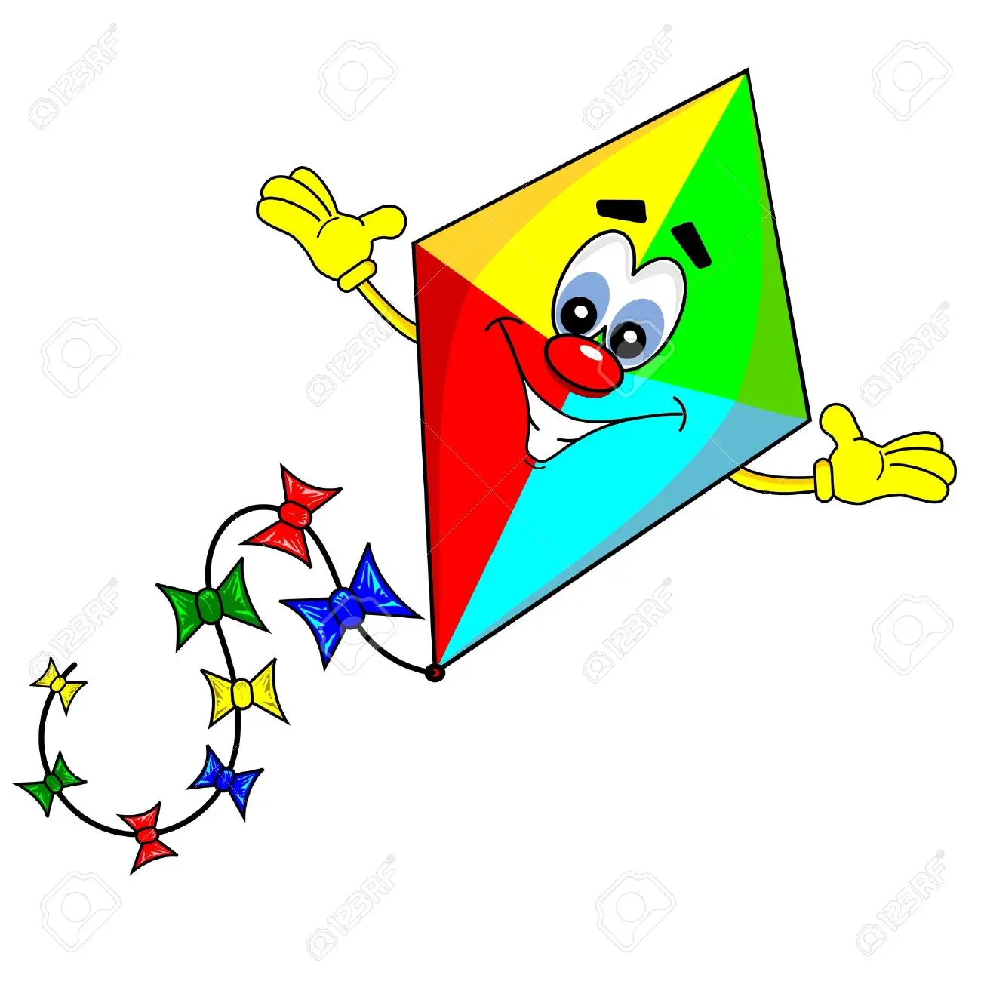

I have got
a kite

Slide 14
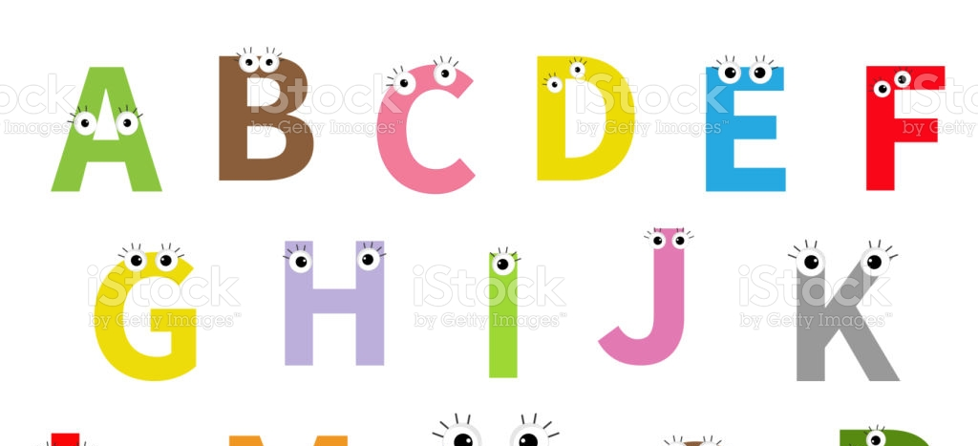





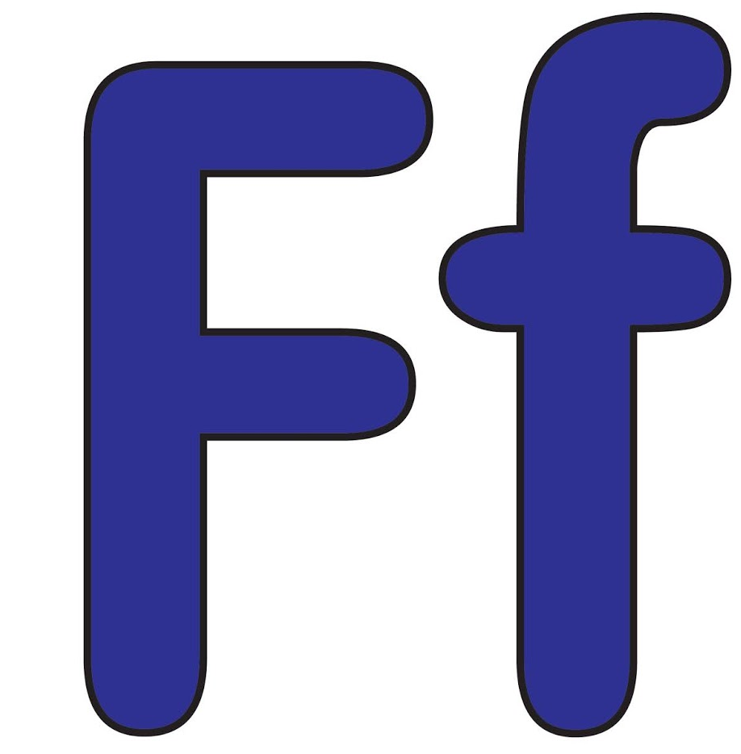


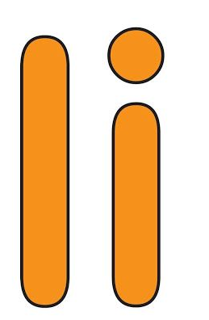

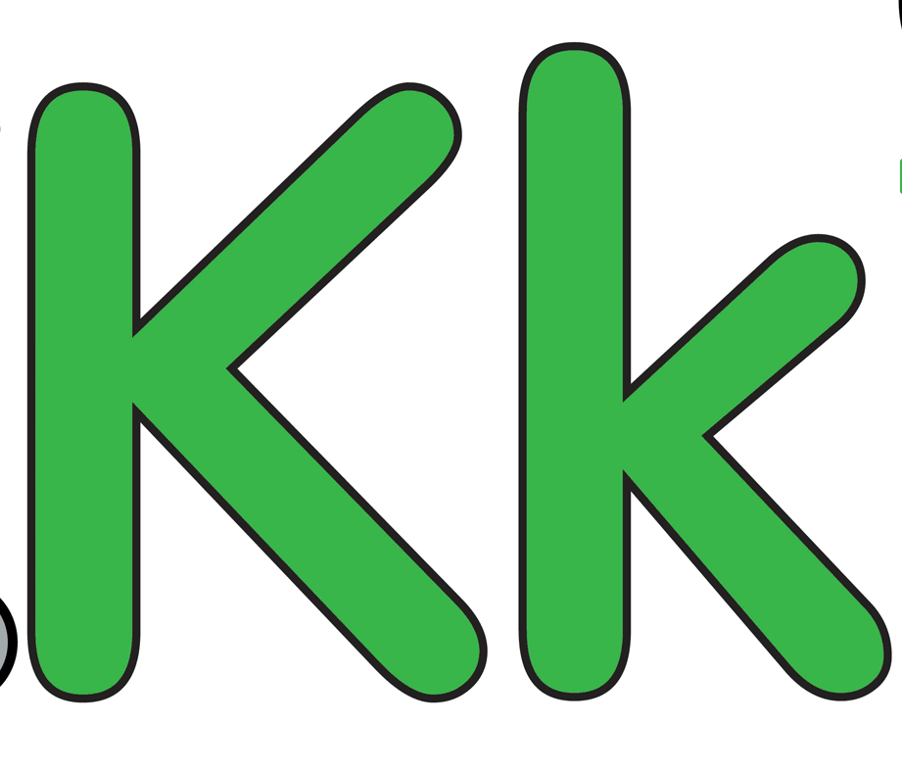
Alphabet

Slide 15

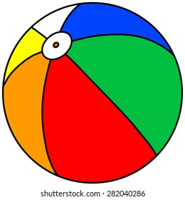
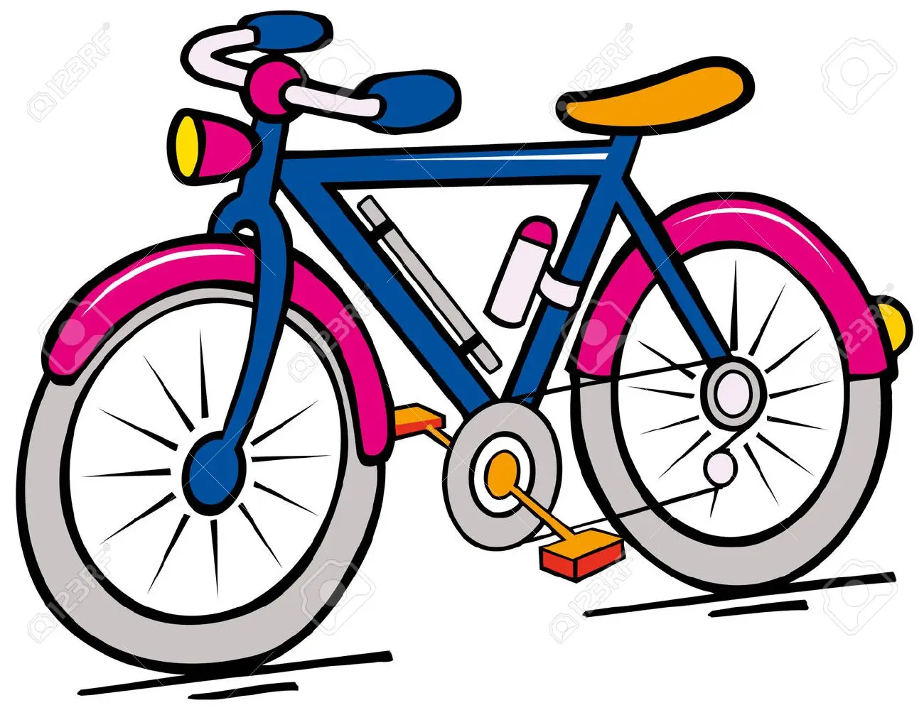
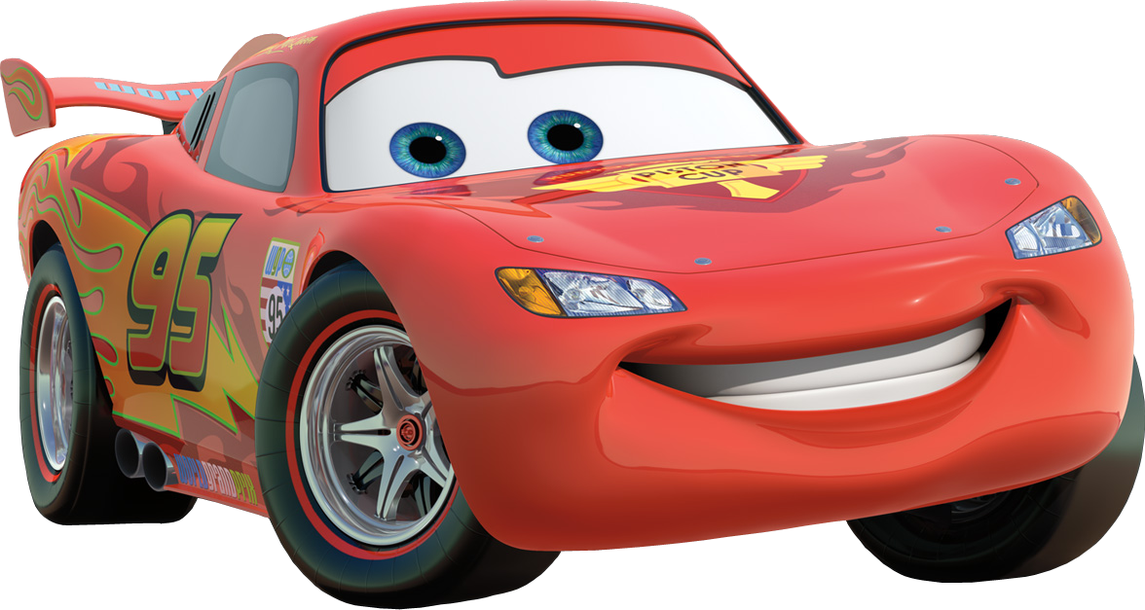
Repeat the letters
English Alphabet
Think , what letter is missing
__ ar
__ ike
__ oll
__ all

Slide 16



