Slide 1
REPORTED SPEECH
COMMANDS AND REQUESTS

Slide 2
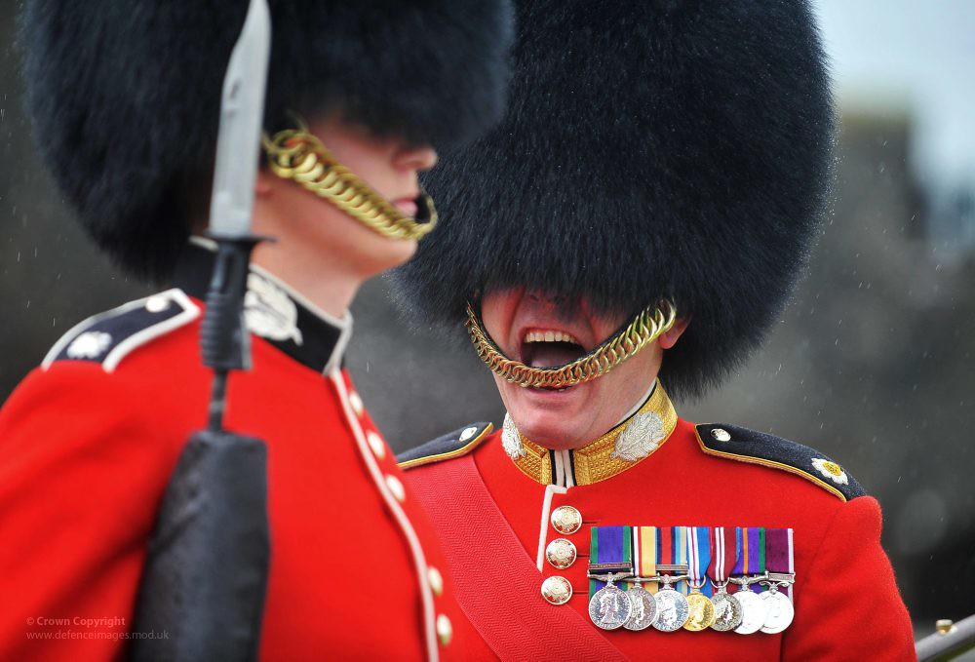
Reporting commands and requests is one form of reported speech. For non-native English speakers is considered to be easier than reporting statements and questions.
Reporting orders
(commands)
A command (order) is when somebody tells you to do something and you have no choice, you have to do it. It is not usually polite. It is a "command".
We usually introduce reported orders with the verb "tell". Look at the following example:
Direct speech | Reported speech
He said: "March!" | He told him to march.

Slide 3
The structure is very simple:
subject + told + noun / pronoun + to infinitive
The fireman told the woman to leave the house.
The teacher told us to submit the homework.
Because we use the infinitive there is no need to change the tense.
But be careful! we may need to change pronouns, time and place, just like we do in reported statements and questions.

Slide 4
Some examples:
Direct order | Reported order
Dad said: "Eat your food!” | He told the boy to eat his food.
The doctor said: “Take these pills 3 times a day“ | The doctor told the patient to take those pills 3 times a day.
She said “Buy some milk in your way home” | She told her husband to buy some milk in his way home.

Slide 5

Aim well, soldier!
The captain told the soldier to aim well.

Slide 6

Reporting requests
A request is when somebody asks you politely to do something. Generally, this person addresses to you with the word “please”.
We usually introduce reported requests with the verb “ask". Look at the following example:
Direct speech | Reported speech
He said: “please, behave" | He asked her to behave.
As you can notice, the way we report requests is the same way we report orders (same structure), we just have to replace the verb TOLD by ASKED, giving us a sense of politeliness.

Slide 7
Some examples:
Direct request | Reported request
The nurse said: "Eat your food, please!” | She asked the boy to eat his food.
George said “please call me at 7“ | George asked me to call him at 7.
She said “turn off the TV, please” | She asked her son to turn off the TV.

Slide 8
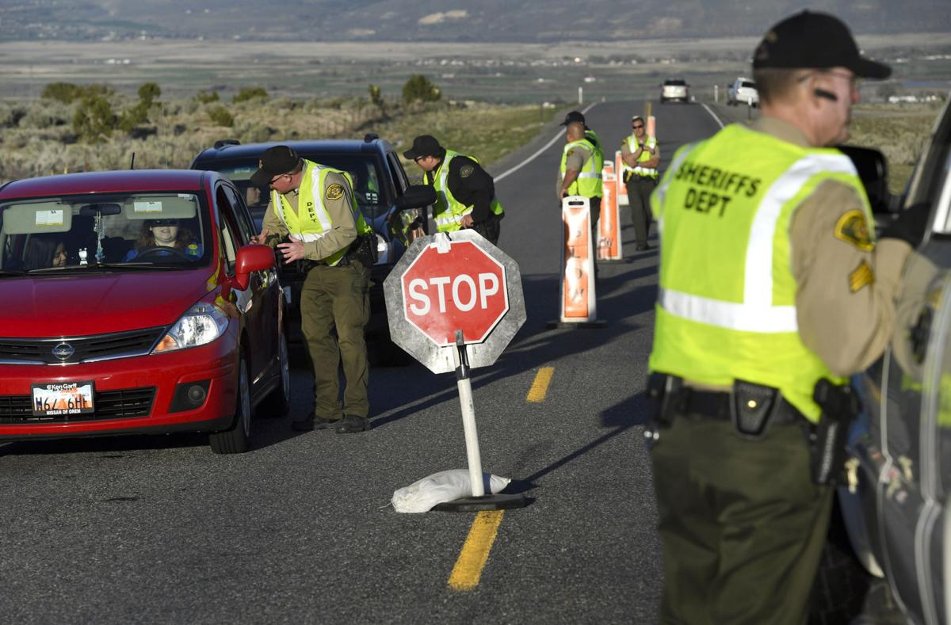
Show me your license,
please.
The police officer asked the driver to show him his license.

Slide 9
IMPORTANT NOTE:
When the order or request is negative, the structure is the following one:
subject + told /asked + noun / pronoun + NOT to infinitive
Sonia asked her husband NOT TO go out.
The teacher told the students NOT TO cheat during the exam.

Slide 10

Don’t smoke, please!
Kirsten asked her friend not to smoke.
Now, your turn…

Slide 11
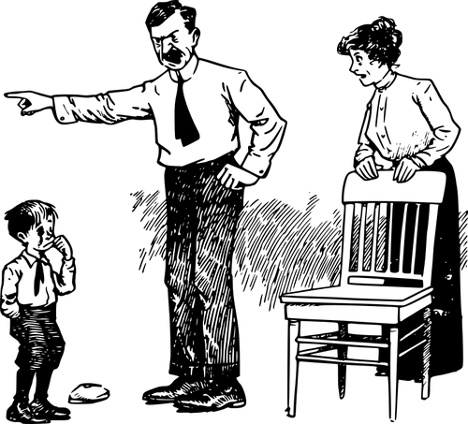
Go to your room!
The father told his son to go to his room.

Slide 12

Please, breath deeply.
The doctor asked her to breath deeply.

Slide 13
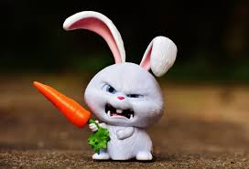
Don’t eat my carrot!
Snowball told everyone not to eat his carrot.

Slide 14
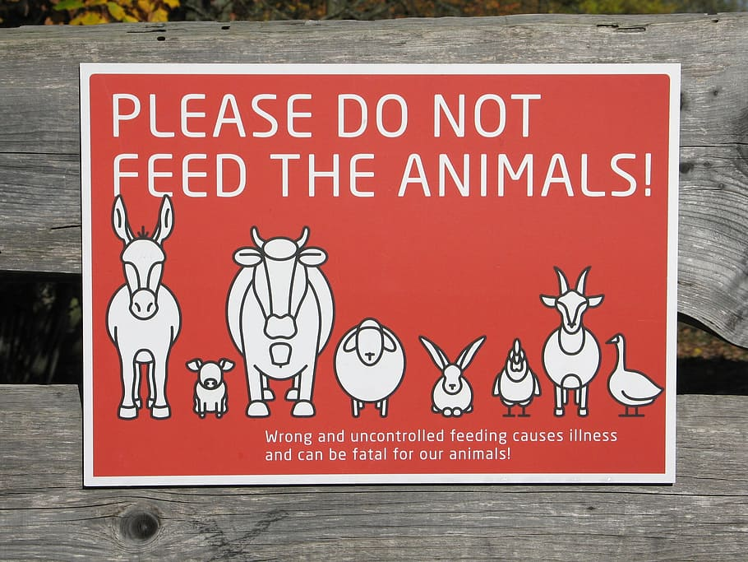
The advertisement asked people not to feed the animals.

Slide 15

Help your mother!
He told him to help his mother.

Slide 16
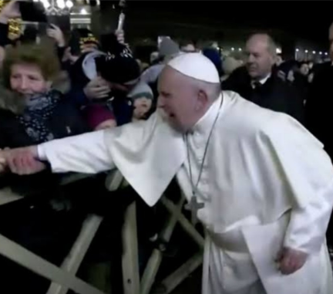
Do not kiss my hand!
The Pope told the woman not to kiss his hand.

