Slide 1
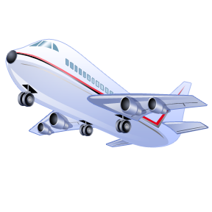

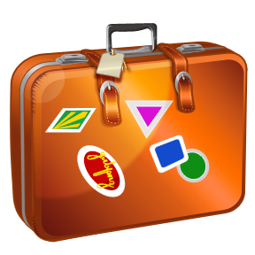
HOLIDAY TRAVEL

Slide 2
Planning your holiday
MONEY
TYPE OF HOLIDAY
DESTINATION
ORGANIZATION
You need to set your budget – how much you can spend
Seaside relax, cruise, sightseeing, fishing, active holiday – climbing, snowboard, other sports activities ...
Choose the location - country, town or city, holiday resort, mountain range, sea...
Plan your holiday alone, contact travel agency - package holiday or compromise - get the basic packet and plan your extras ...

Slide 3
 YOUR LAST HOLIDAY 
When was your last family holiday?
Who planned the holiday?
What kind of holiday was it?
Where did you go?
Who chose the location?
How was the holiday organized?
What was your favourite trip, city or activity during your holiday?
Did you have the opportunity to use your English? Describe the situation.

Slide 4
BEFORE LEAVING
PASSPORT or ID
Make sure your passport (global travel) or ID (travel within the EU) is valid
INSURANCE
Get travel insurance if it is not already included in your packet holiday
EXCHANGE
Exchange the local currency or have credit on your pay card

Slide 5


 YOUR HOLIDAY 
Do you have a passport?
Have you ever lost or forgotten your passport?
Do you get travel insurance every holiday?
Have you ever needed it?
Where do you exchange the currency?
Do you use your pay card abroad?

Slide 6


Useful items
FIRST AID KIT - just in case
CELL PHONE AND CHARGER
MEDICAL SUPPLIES - your regular medicine
MAPS for your active holiday if not included in your mobile
DICTIONARY when travelling abroad
CAMERA

Slide 7
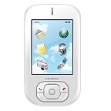
 YOUR useful items 
What are your personal useful items?
What is your item number one?
Have you ever got lost during your holiday? Did you have a map?
Have you ever used a first aid kit while on holiday?
Have you ever been on holiday without a camera or mobile phone?
Do you take a dictionary when visiting foreign countries?

Slide 8
Means of transport
ON FOOT
BOAT
AIRPLANE
TRAIN
BUS
CAR
BICYCLE

Slide 9
 BEST WAY TO TRAVEL 
What is your favourite means of transport on holiday?
What do you like about it?
Which way do you use most often?
Think about the advantages and disadvantages of other means of transport? Consider for example price, speed, independence, comfort, relax, being active.
Can you think of some unusual means of transport?

Slide 10

types of holiday
Seaside holiday resort – beach time
Mountain holiday resort – skiing, snowboarding
Camping holiday or backpacking holiday
Sightseeing holiday
Spa holiday
Cruise holiday - sailing
Fishing / hunting holiday
Sports holiday
Combined holiday …

Slide 11

 YOUR types of holiday 
What kind of holiday have you experienced?
What was your best holiday ever? Why?
Which kind of holiday would you never choose again?
Which one would you like to try? Why? Who would you take with you?
Can you think of another type of holiday to be added to the previous list?
What would be the best time for your parents?

Slide 12


 Write about your holiday 
Choose one particular holiday you would like to write about. It could be your best, worst or just last.
Brainstorm some ideas you would like to mention.
Prepare an outline – you can use the previous slides as an inspiration and of course you can add some extra information.
Write a personal letter to your friend and tell him/her about your holiday.

