Slide 1







Great Britain
in facts and numbers

Slide 2




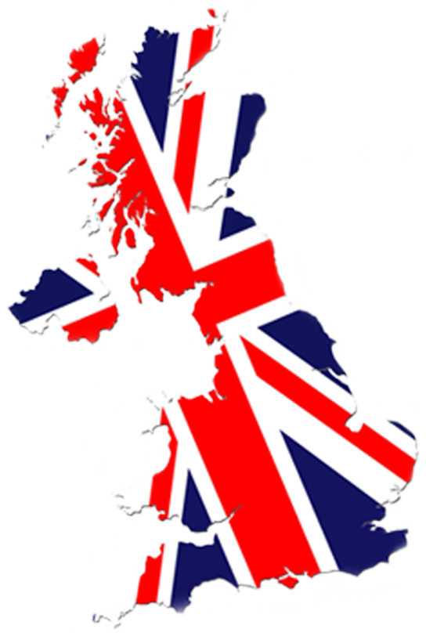








Slide 3


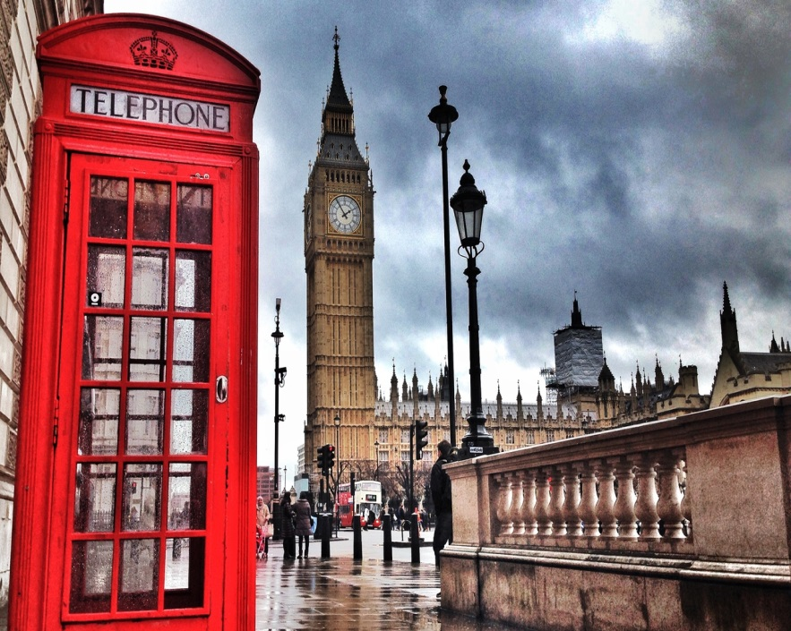
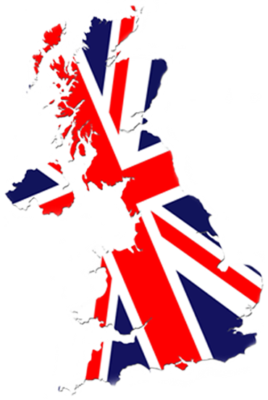
total
243.610
km²
capital
London
AREA

Slide 4
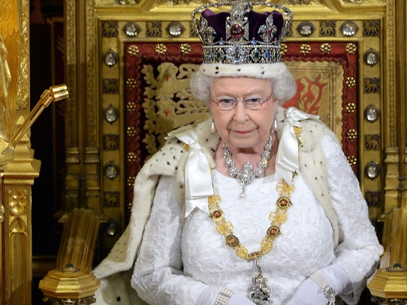

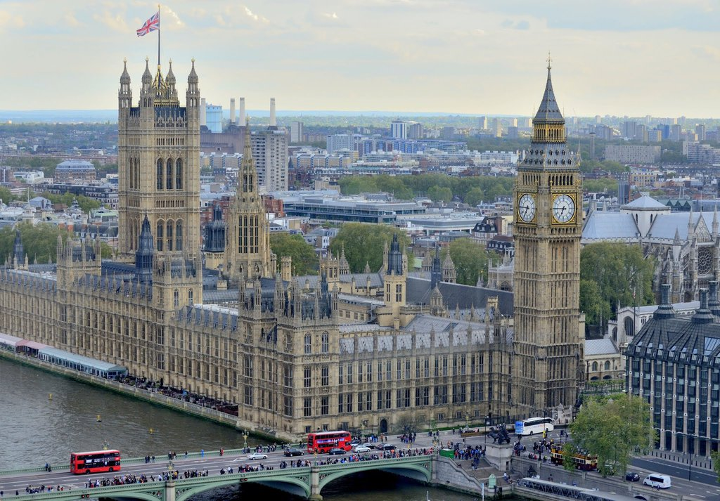
Unitary
Parliamentary
Constitutional
monarchy
GOVERNMENT

Slide 5






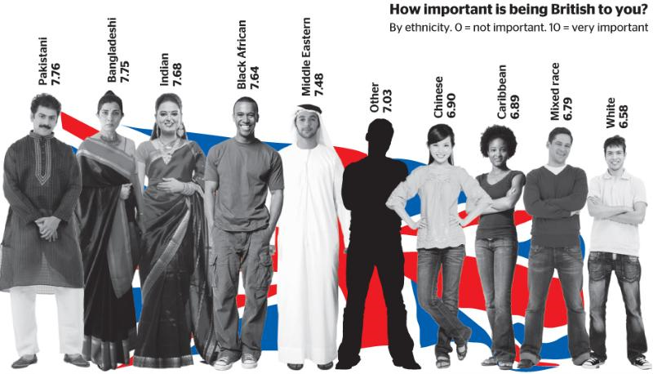
65. 2
million
33 million
32 million
POPULATION

Slide 6

English
LANGUAGE
Minority languages officially recognized:
Welsh, Scottish Celtic, Scottish, Cornish, Irish.
The main languages of immigrants: Arabic, Punjabi, Bengali, Siraiki, Urdu, Sylheti, Greek, Italian, French, southwestern Caribbean Creole, Gujarati, Kashmiri, Polish, Russian.

Slide 7

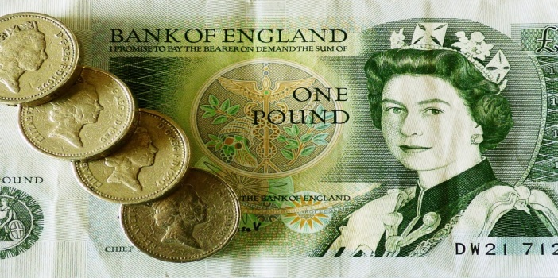
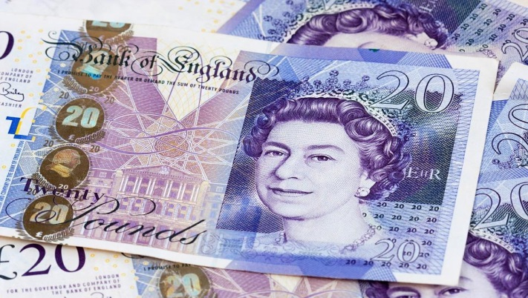
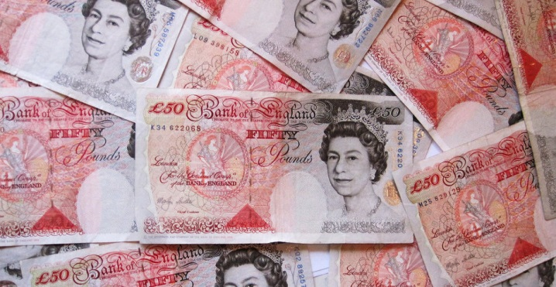
pound
sterling (GBP)
CURRENCY

Slide 8
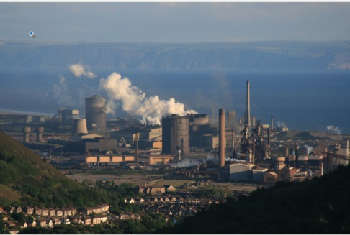
INDUSTRY

Slide 9

ECONOMY
GDP is 2.678 trillion US dollars in 2016
GDP growth rate 1,8 %
GDP per capita 40 420$
unemployment rate 4,7%
total public debt 89% of GDP
international reserves 130 billion

Slide 10





TRANSPORT
Great Britain is an island nation, so all of its external transportation and trade are related to sea and air transport. Great Britain is connected with the continent by a tunnel under the English channel.

Slide 11






RELIGION

Slide 12




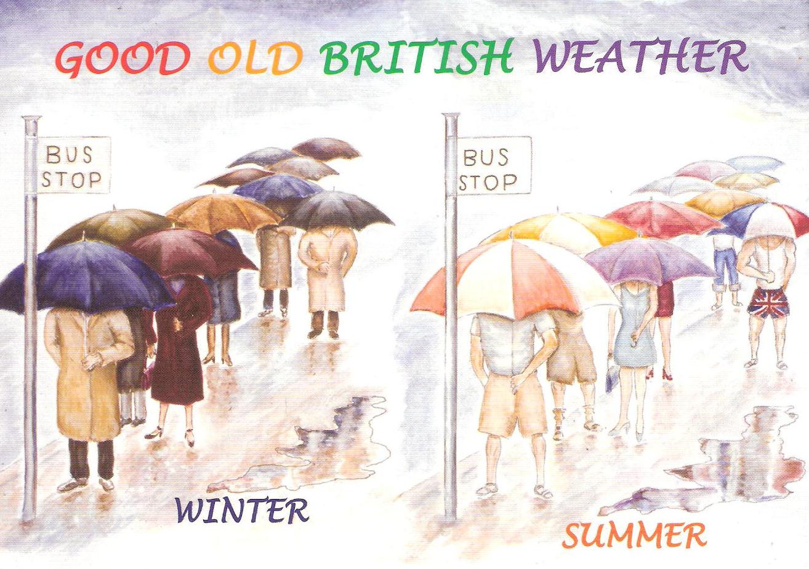




WEATHER

