Slide 1
THE CAUSATIVE FORM
have/get something done

Slide 2
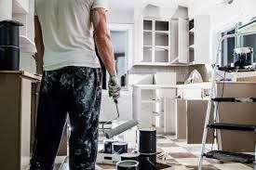
A month ago
James painted his house.
But… it was a disaster!!!

Slide 3
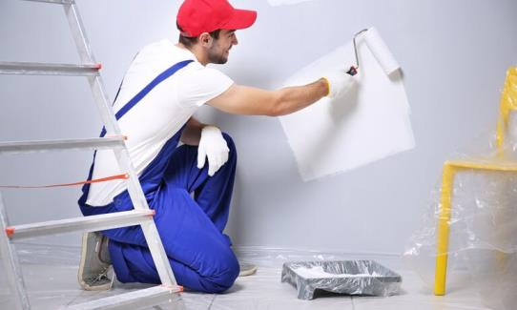
So he decided to call a professional painter.
Last Sunday,
James had/got his house painted.

Slide 4
Causative Form
have something done
get something done

Slide 5
Present Simple have
Present Continuous am/is/are having
Past Simple had
Past Continuous was/were having
Present Perfect Simple has/have had
Present Perfect Continuous has/have been having
Past Perfect Simple had had
Past Perfect Continuous had been having

Slide 6
Future Simple will have
Future Continuous will be having
Future Perfect Simple will have had
Future Perfect Continuous will have been having
Infinitive (to) have
Gerund having

Slide 7
Present Simple get
Present Continuous am/is/are getting
Past Simple got
Past Continuous was/were getting
Present Perfect Simple has/have got
Present Perfect Continuous has/have been getting
Past Perfect Simple had got
Past Perfect Continuous had been getting

Slide 8
Future Simple will get
Future Continuous will be getting
Future Perfect Simple will have got
Future Perfect Continuous will have been getting
Infinitive (to) get
Gerund getting

Slide 9
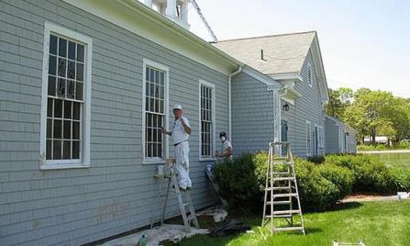
They paint the windows every spring.
They ……………………………………………….. every spring.
They ……………………………………………….. every spring.
have the windows painted
get the windows painted

Slide 10
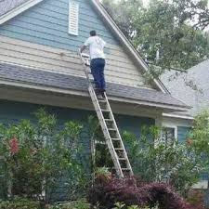
He is fixing the roof now.
He ……………………………………………….. now.
He ……………………………………………….. now.
is having the roof fixed
is getting the roof fixed

Slide 11

He installed a new game yesterday.
He ……………………………………………….. yesterday.
He ……………………………………………….. yesterday.
had a new game installed
got a new game installed

Slide 12
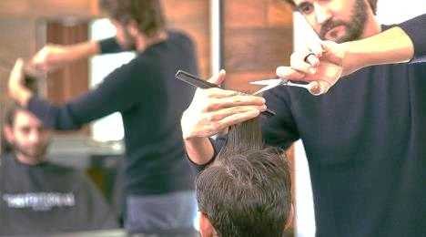
He was cutting his hair yesterday morning.
He ……………………………………………….. yesterday morning.
He ……………………………………………….. yesterday morning.
was having his hair cut
was getting his hair cut

Slide 13
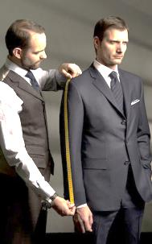
He has made a new suit.
He ………………………………………………..
He ……………………………………………….. .
has had a new suit made
has got a new suit made

Slide 14
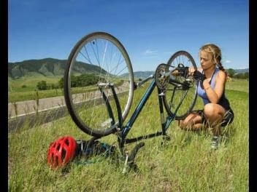
She will repair her bike.
She ……………………………………………….. .
She ……………………………………………….. .
will have her bike repaired
will get her bike repaired

Slide 15


