Slide 1
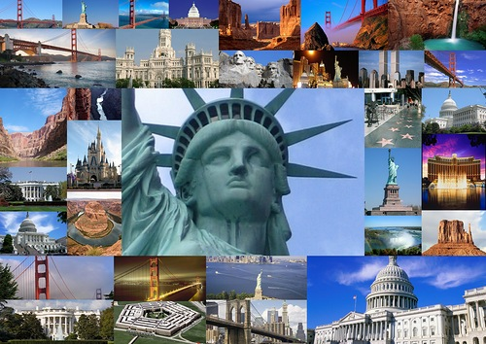
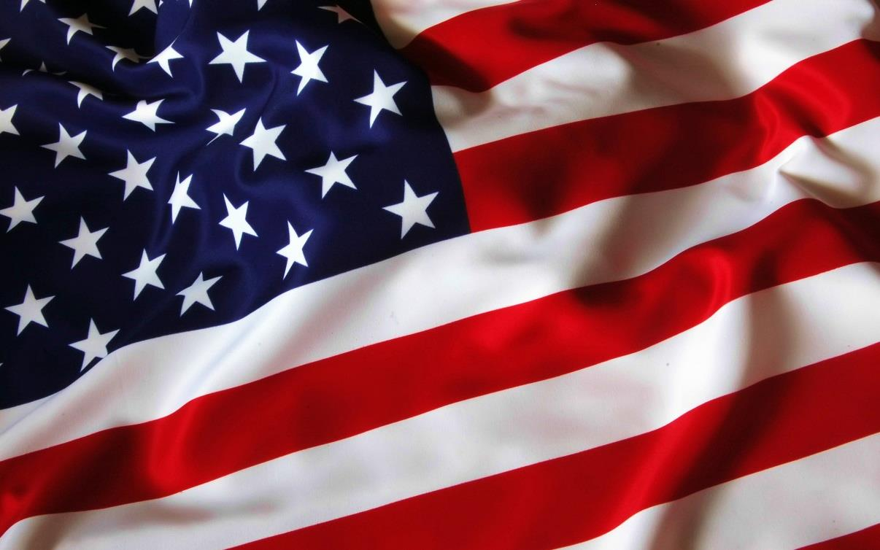
The USA.
Places of Interest

Slide 2
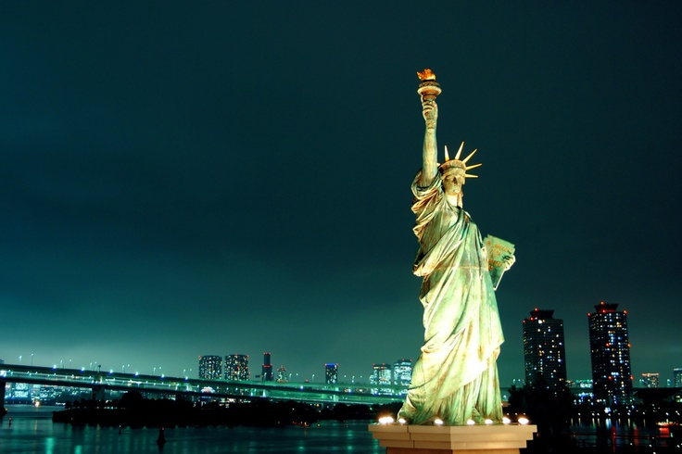
The Statue of Freedom
This statue is the USA national monument, the symbol of freedom, democracy and justice. It is one of the most famous sculpture in the USA and in the world.
The statue is the present of French people to Americans to commemorate the American revolution 100-anniversary . It is situated on the island 3 km far from New York

Slide 3
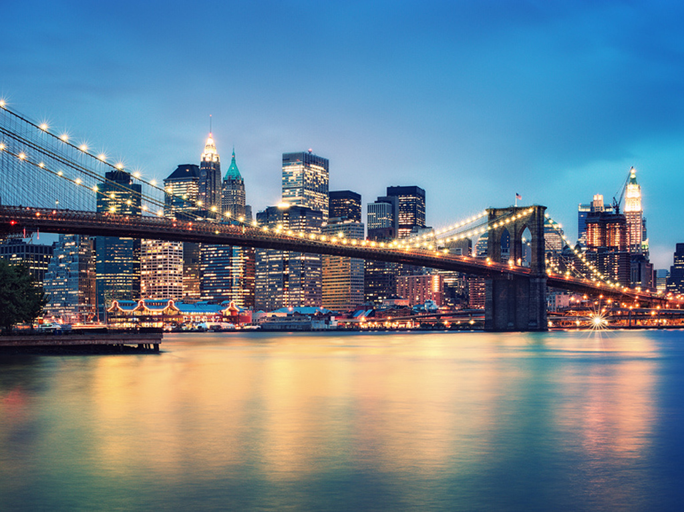
Brooklyn Bridge
Brooklyn Bridge is one of the oldest bridges in the USA.
It is in New York and it crosses the East river
from Manhattan to Brooklyn.
You can see this bridge in many American films

Slide 4
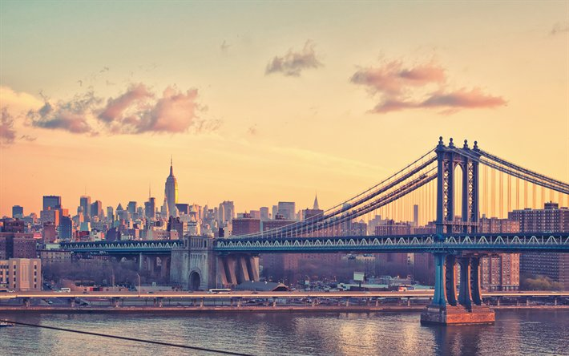
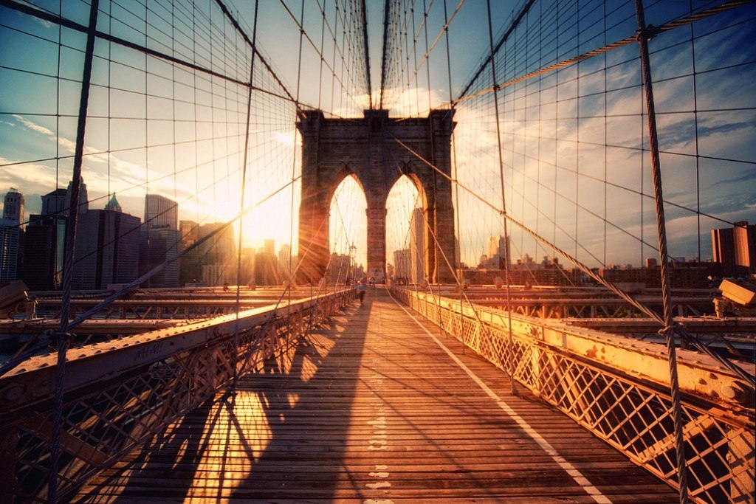
Golden Gate Bridge is one of the oldest hanging bridges in the USA. It is 1825 m long. It has being built during 13 years and costed 15.1 $. About 1800 vehicles and 150 300 people passed across it during the first day

Slide 5
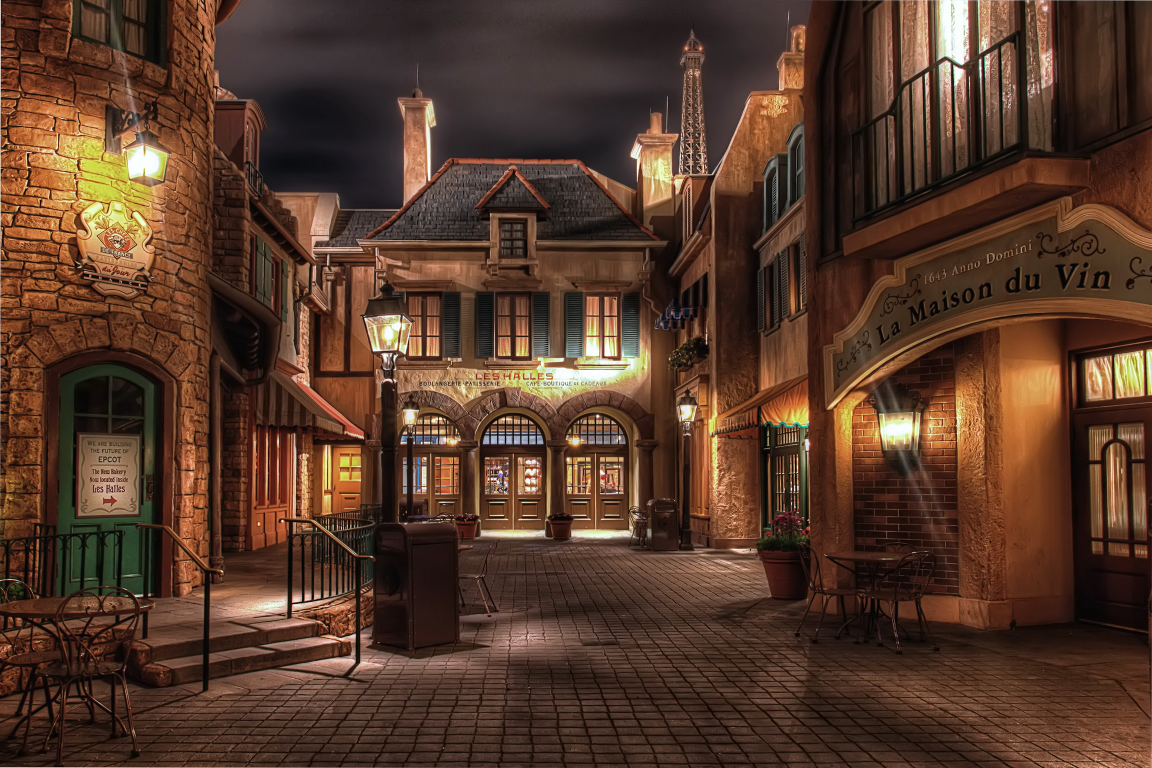
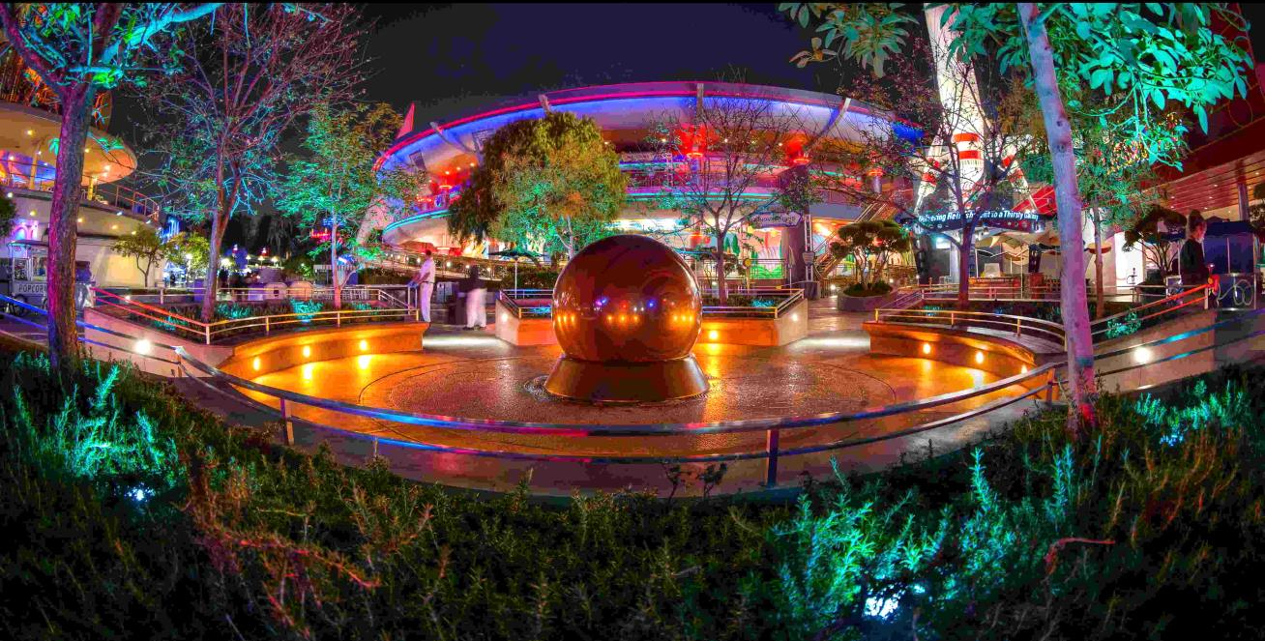
Disneyland
It is a well-known amusement park of Walt Disney Company in the USA, California. It was opened in 1955 and was Walt Disney`s, a famous cartoon director, idea.
He wanted to create the park for children and adults where the cartoons` heroes would come to life . The park is visited by 13.3 million people a year

Slide 6
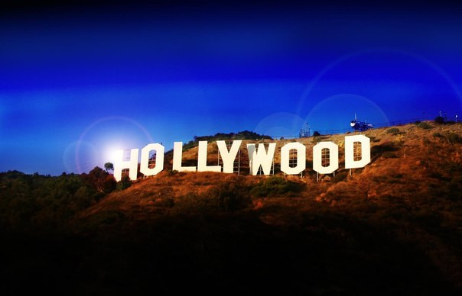
It is the symbol of entertainment industry.
The word “Hollywood” is often used as a synonym
to American cinematography.
It attracts tourists with its Fame Alley and Chinese Theatre TCL.
Paramount Picture Studios and Dolby Theatre,
where the Oscar ceremony is held are also here

Slide 7
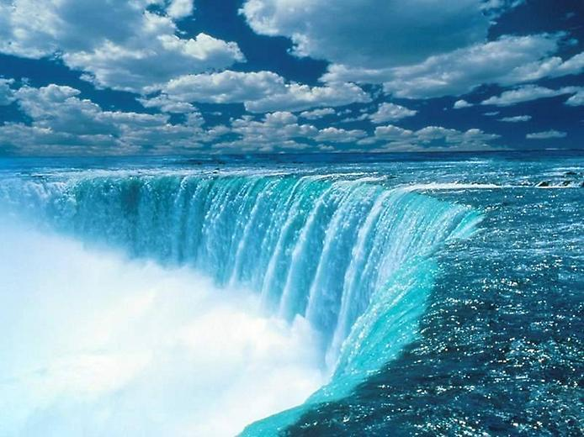
Niagara Falls
It is one of World Wonders visited by 15 ml of tourists every year.
The falls are 50 m high and they are situated on the river Niagara which runs out of Lake Eyre between the USA and Canada. The noise from it is heard from 20 km from here

Slide 8
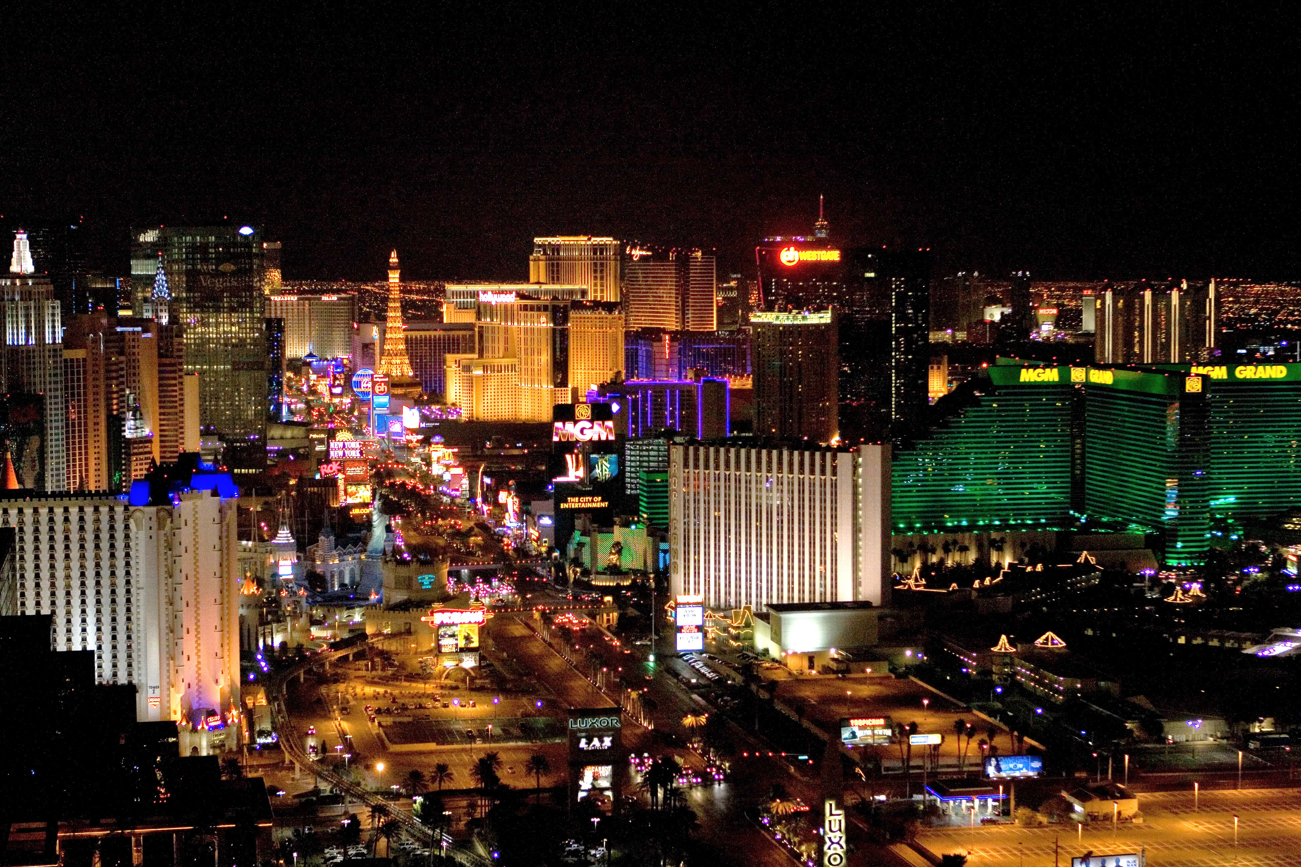
Las-Vegas
It is a well-known city in Nevada state in the central part of the desert Mohave.
Its population is 560 000 people.
This city is the world center of entertainment and playing business.
Casinos, hotels, every day concerts and shows attract tourists from all over the world

Slide 9
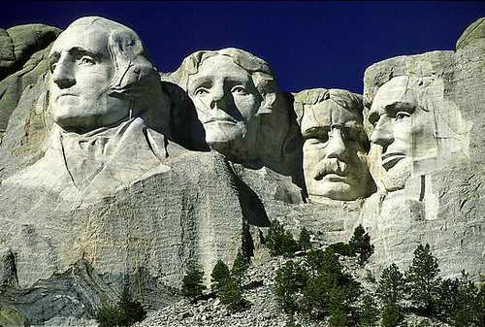
National Memorial
Mount Rashmour

Slide 10
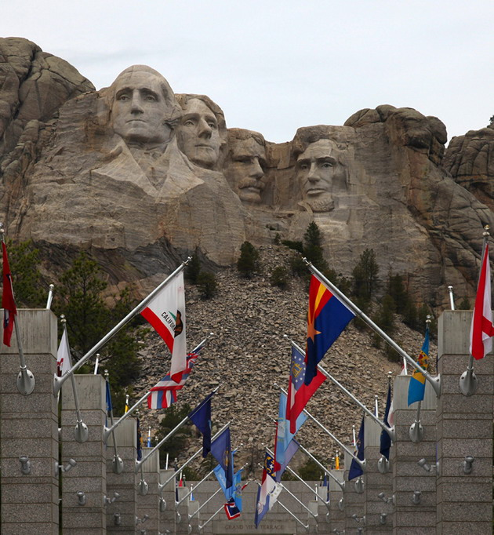
The figures were being built during 1927 - 1941. More than 400 people were working at the sculpture composition. It was named after the American businessman Charles Rashmour who gave 5000 $ on the building in 1930

Slide 11
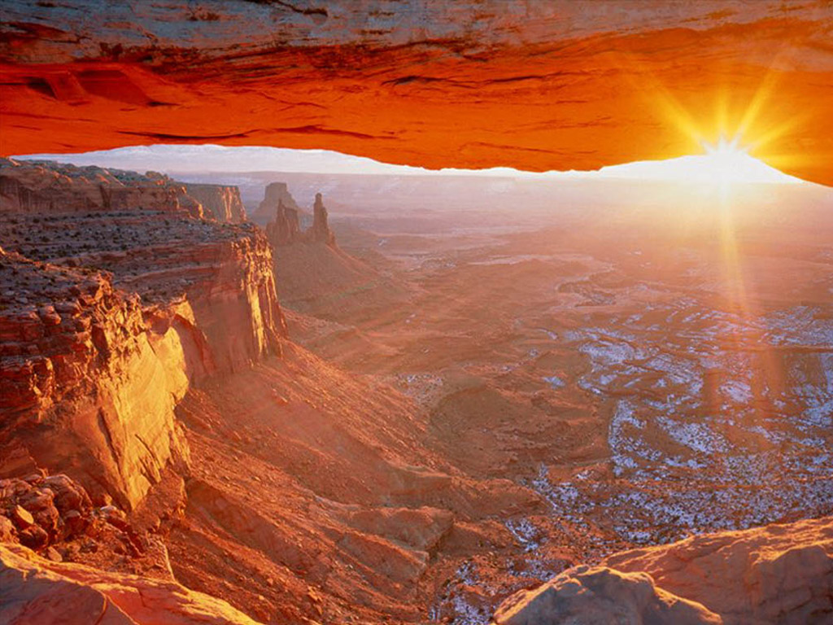
Colorado Great Canyon

Slide 12
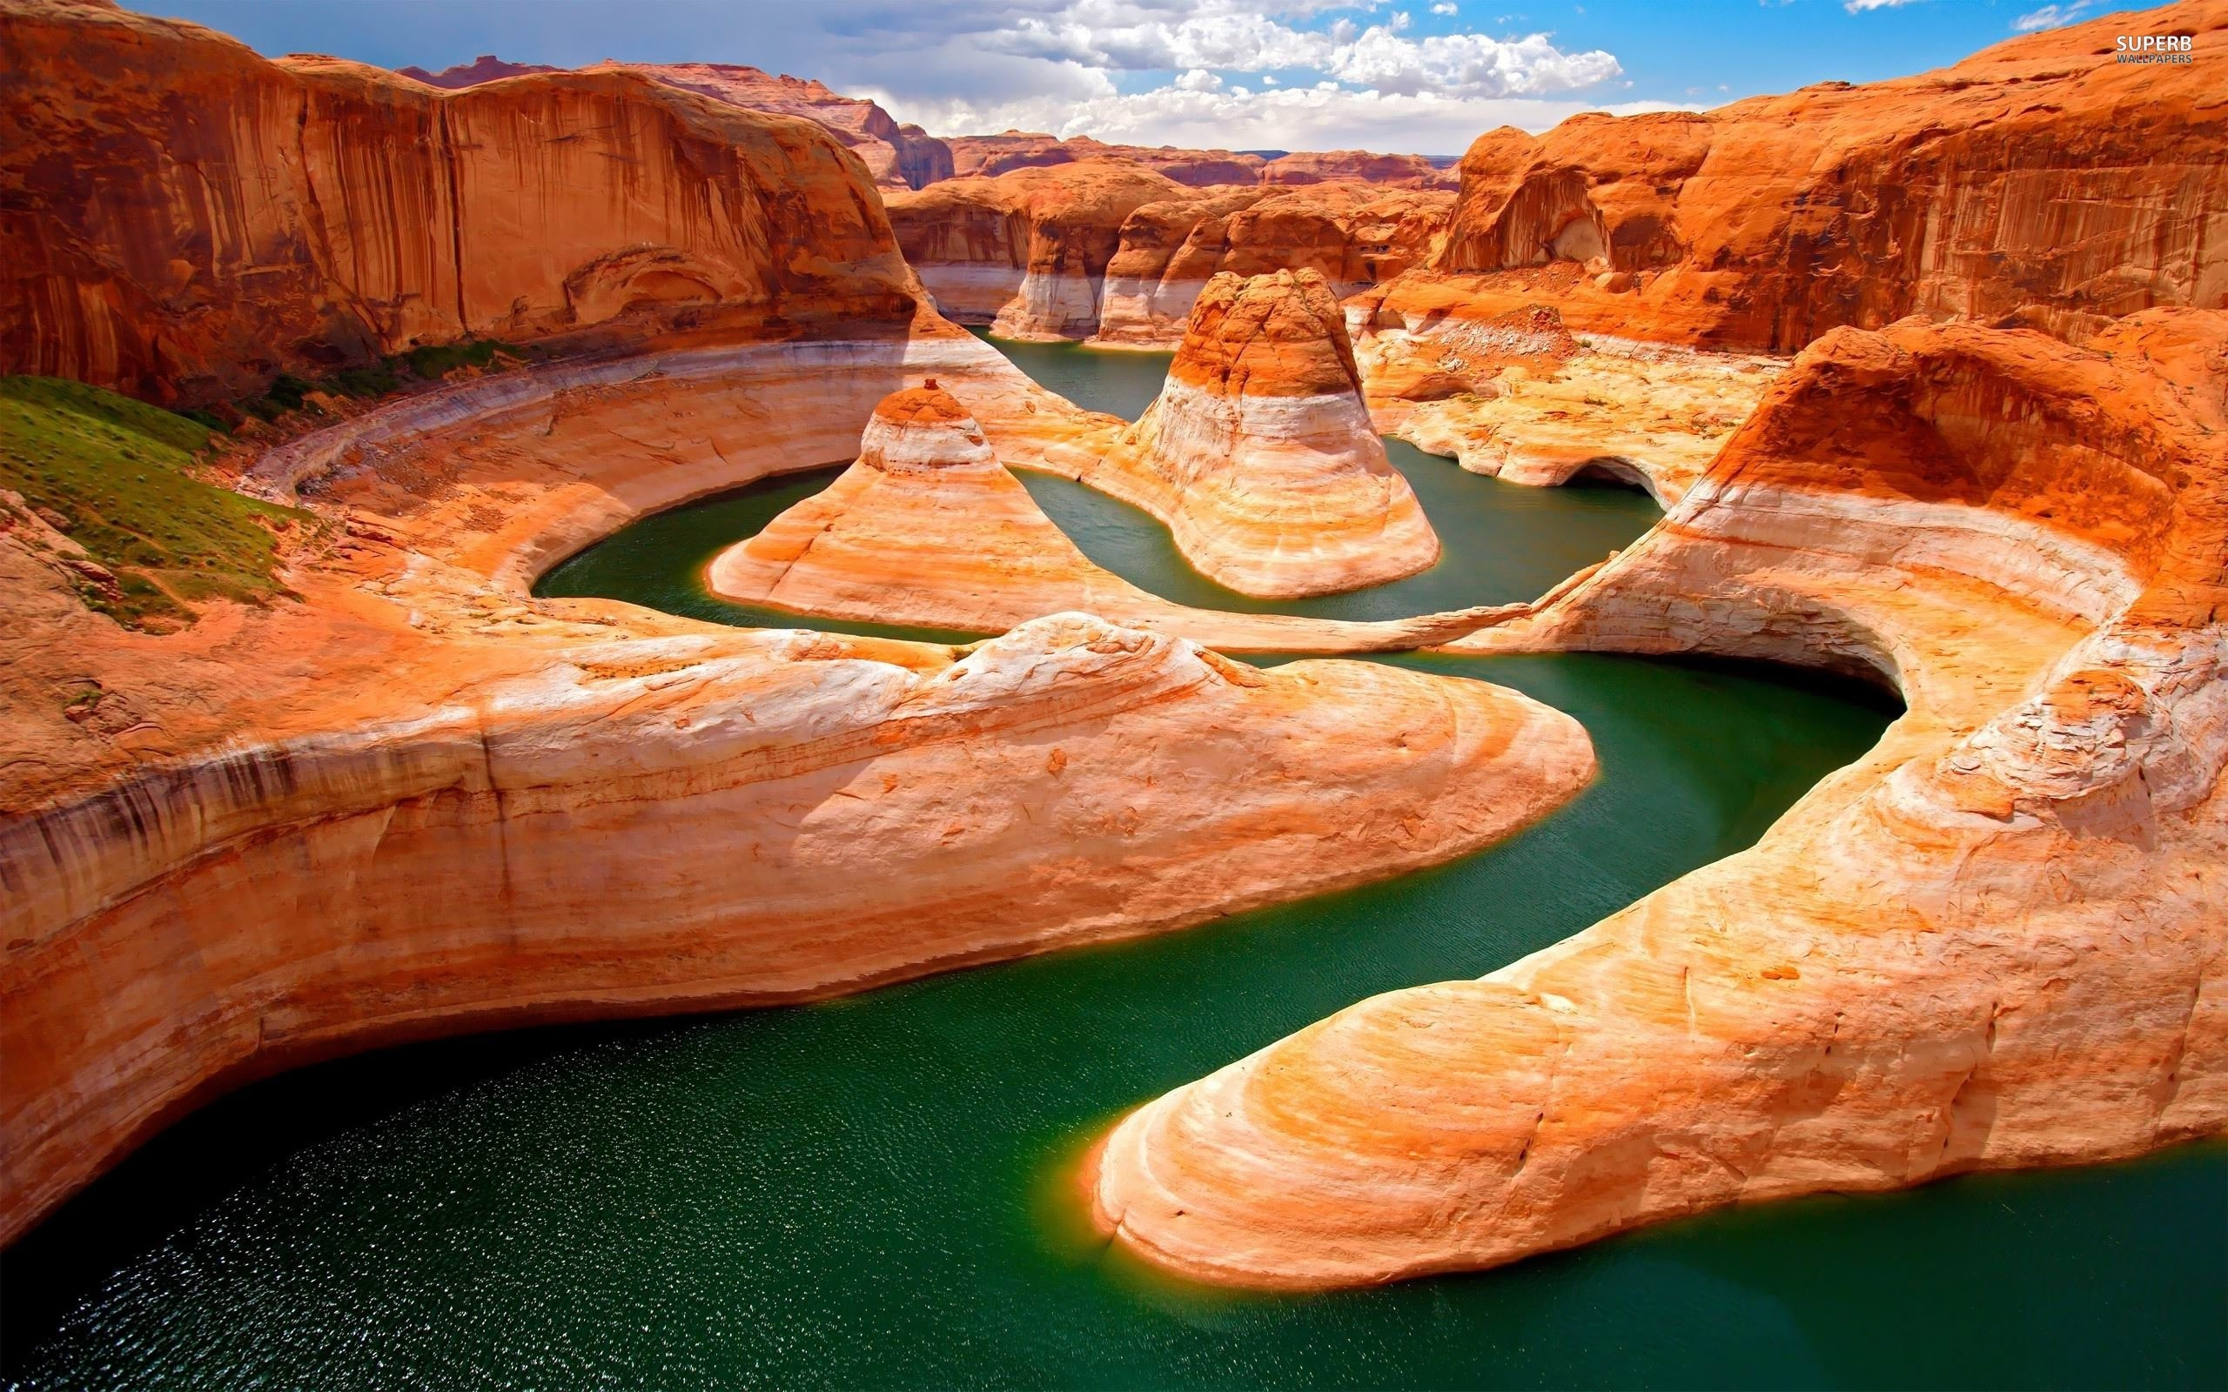

Slide 13
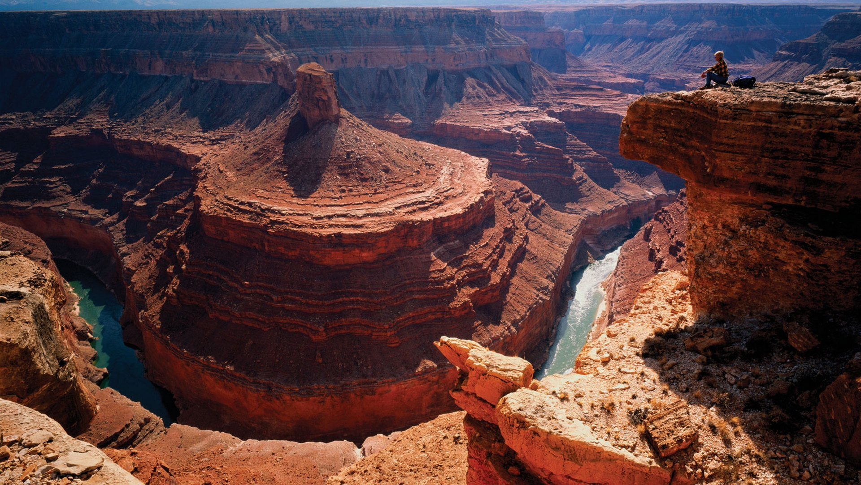
This canyon is characterized by unusual forms of relief: towers, bastions and the color of rocks.
It is a little over 1 ml years old. The canyon is extremely deep and was formed by the Colorado river which runs with the speed
of 25 km/h

Slide 14
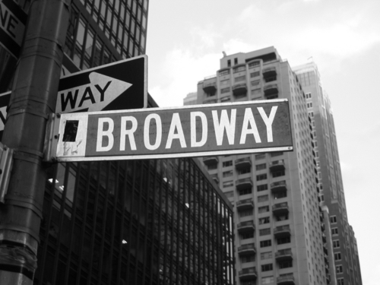

Slide 15
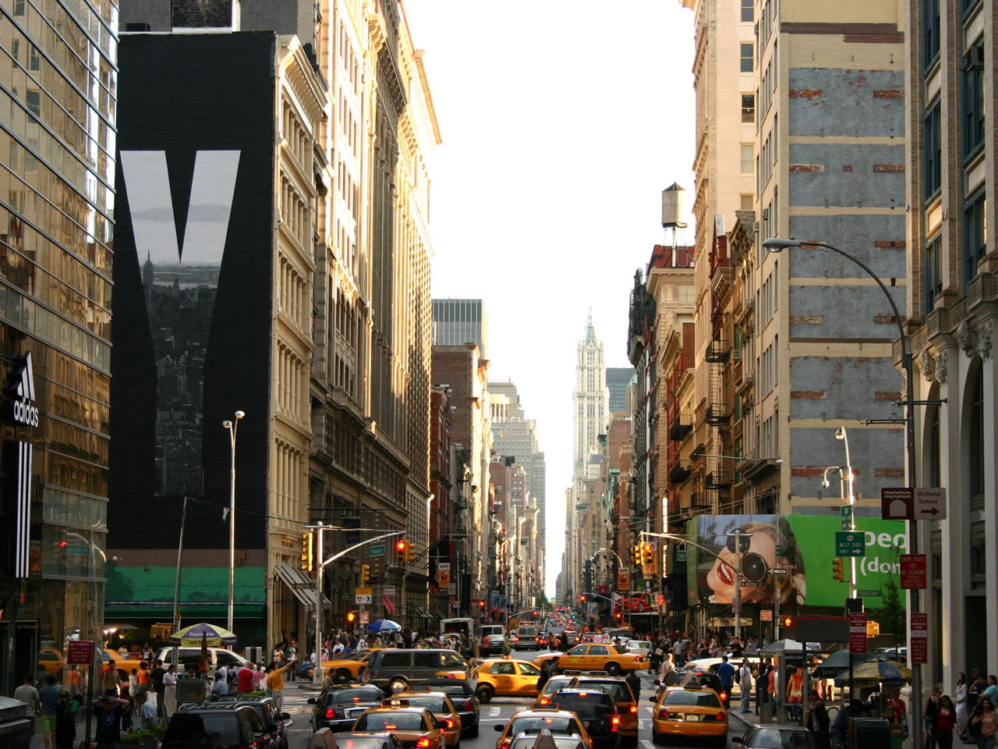
It is the longest New York street which is 25 km long and runs through the whole Manhatten, Bronx and further north to the Olbany city, the capital of New York state.
It`s not straight, but it curves like waves

Slide 16
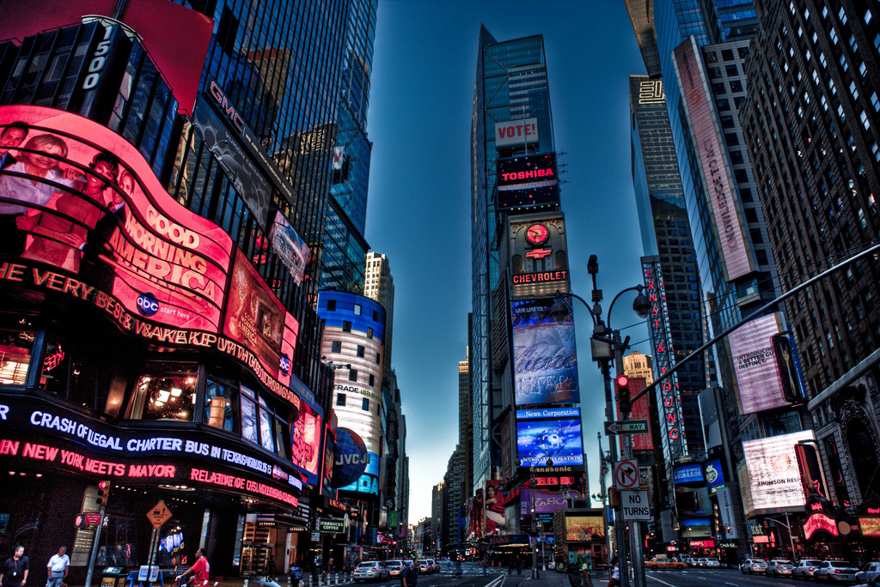
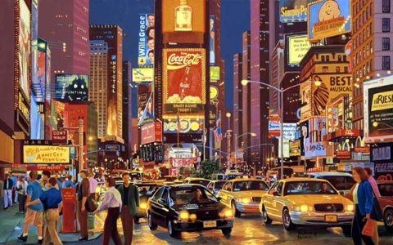
In the place where Broadway crosses the 42 th street there is Times Square (named after the famous newspaper “The Times”).
Popular theatres are situated here that`s why the name is the synonym to American theatre art

Slide 17
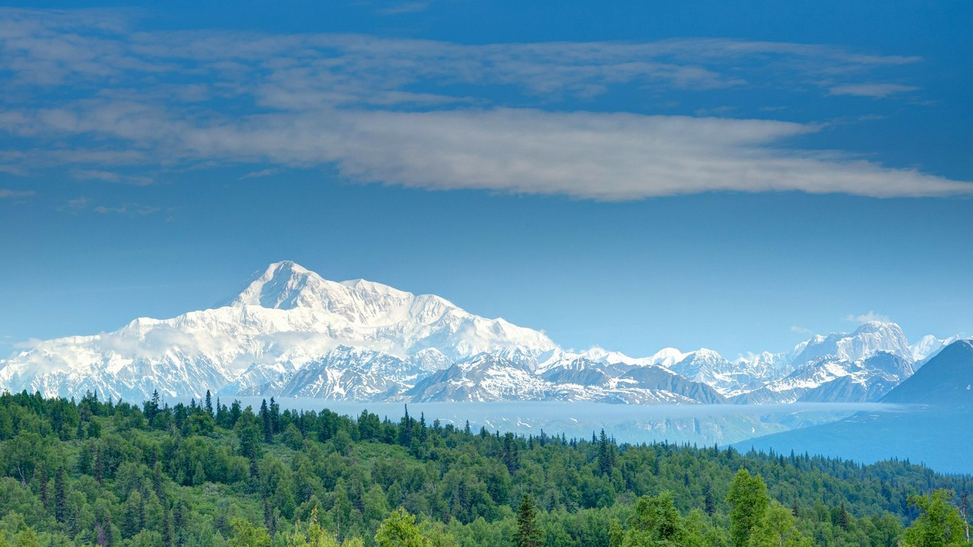
Mount Mac-Kinly, Alaska

Slide 18
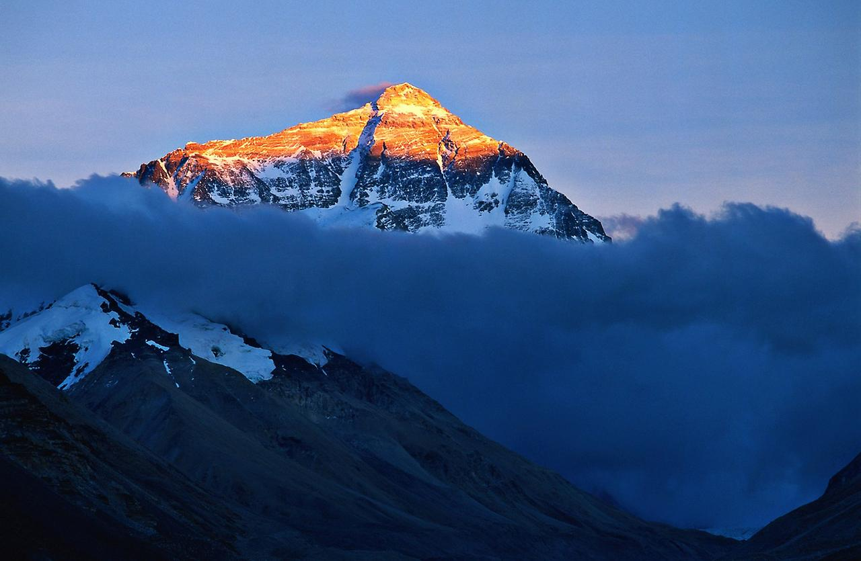
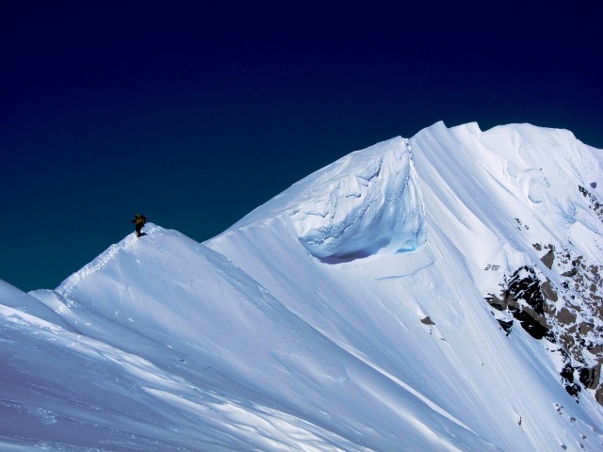
In the southern part of Alaska the highest mountain of the USA mount Mac-Kinly is situated. It is the main place of interest in the National Park and Denaly Reserve. A great number of rivers and lakes are situated here

Slide 19
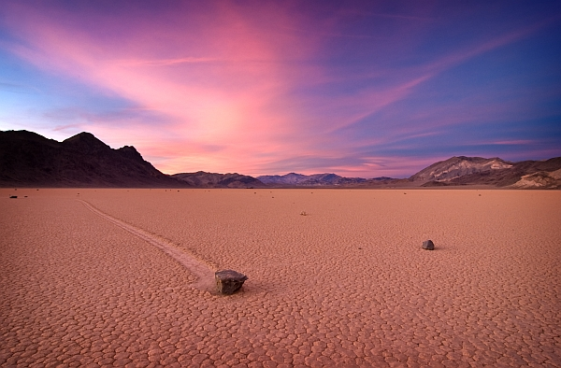
The Death Valley

Slide 20
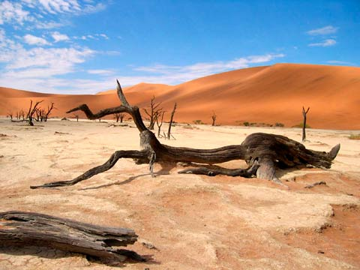
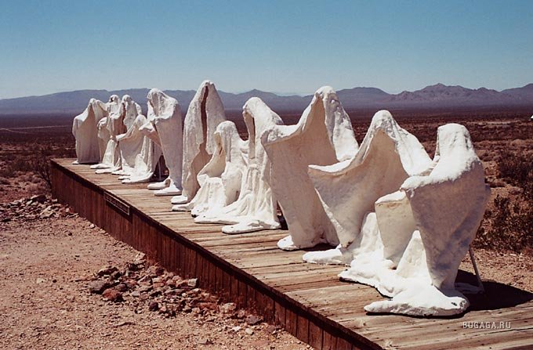
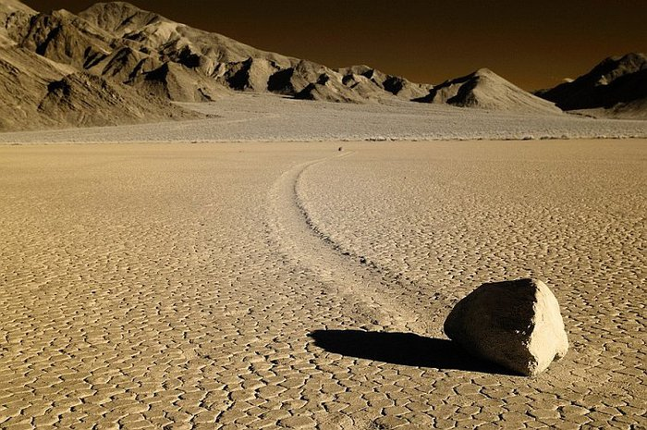
It is the lowest place on the continent. The highest temperature was fixed here. High dunes, pale yellow color of the ground and also magnificent rocks are beautiful in the light of the sun. Despite of its name, The Death Valley is charming and various as for its flora and fauna

