Slide 1
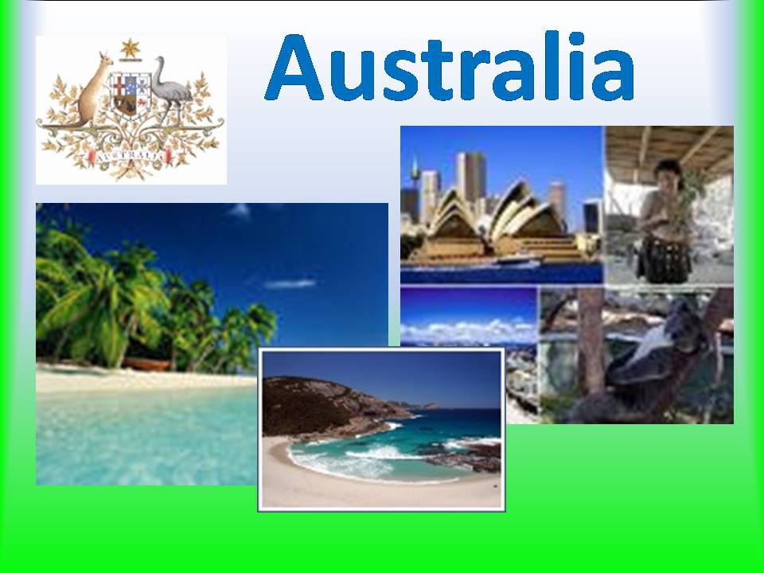

Slide 2
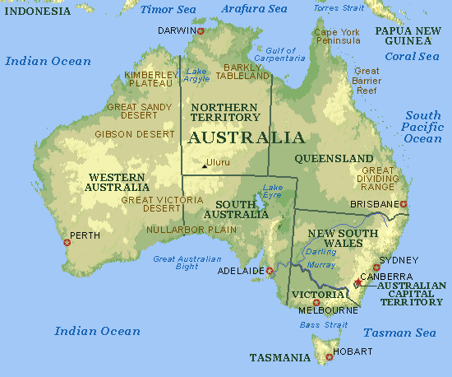
Australia is a self-governing federal state. It is situated in the southwest of the Pacific Ocean, occupying the continent of Australia and a number of islands, of which Tasmania is the most important.

Slide 3
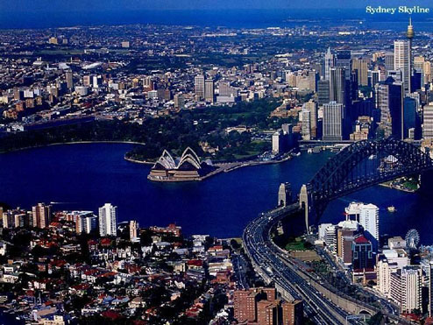
Australia is a continent-island washed on its western shoreline by the Indian Ocean and on its east coast by the Pacific Ocean. Australia has an area of 2,965,00 square miles, includes six states and two territories.

Slide 4
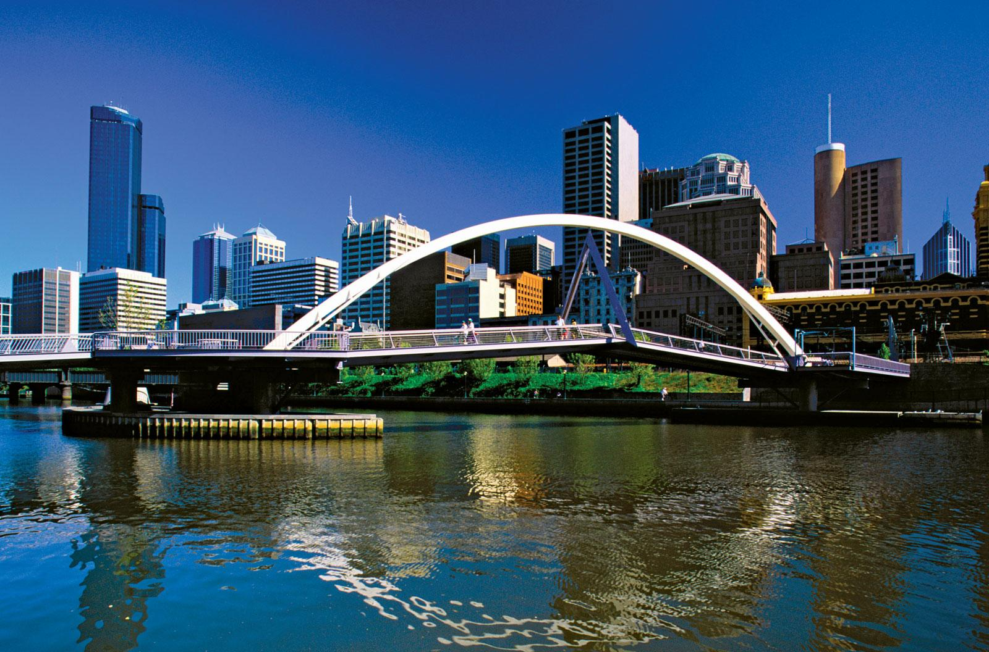
16 million people now live in Australia. The federal capital of the country is Canberra

Slide 5
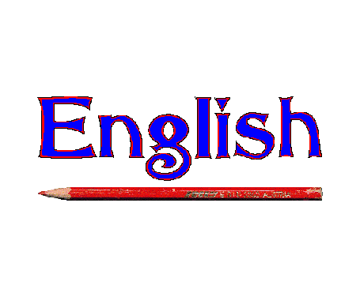
The official language is English.

Slide 6
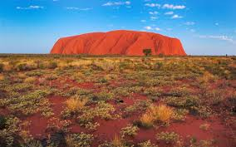
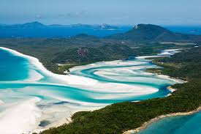
Australia’s climate is warm and dry. As Australia is situated in the south hemisphere, it has winter when we have summer in the northern hemisphere, and summer when we have winter. Summer is from December to February; autumn (fall) Mach to May; winter – June to August; and spring – September to November.

Slide 7
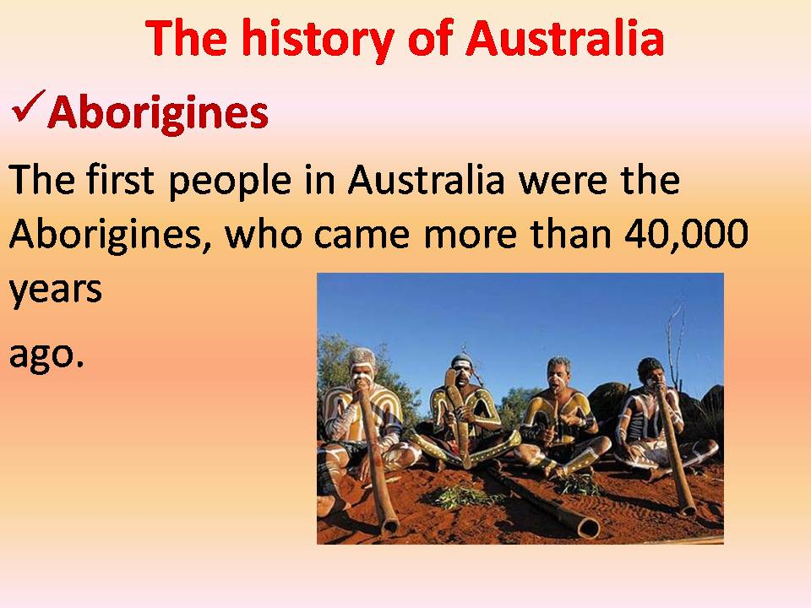

Slide 8
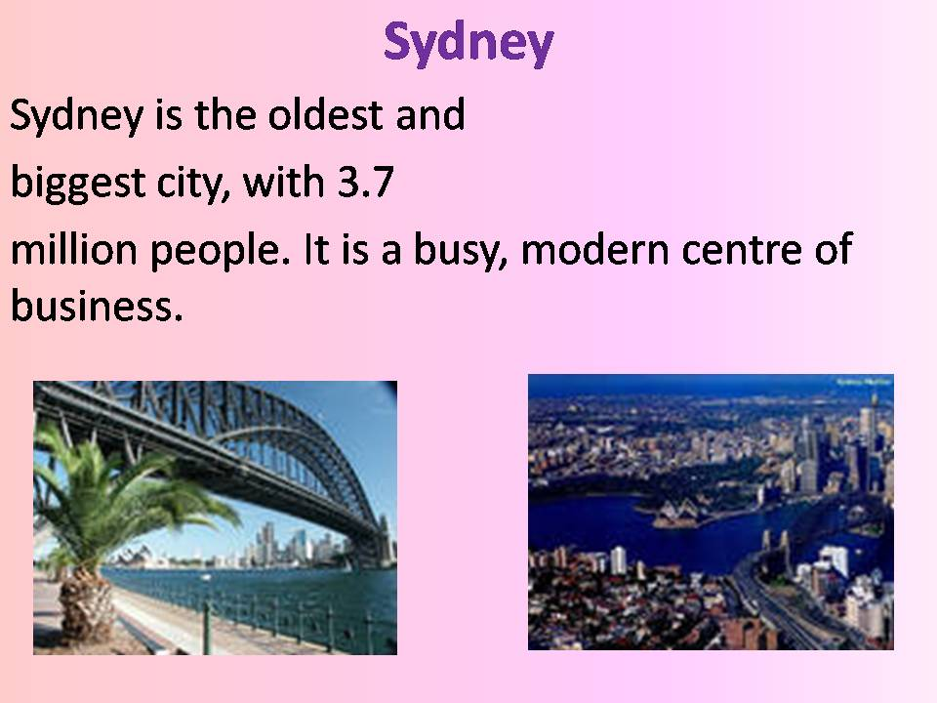

Slide 9
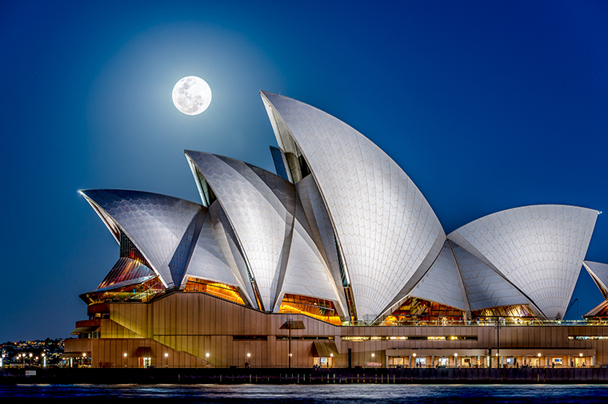
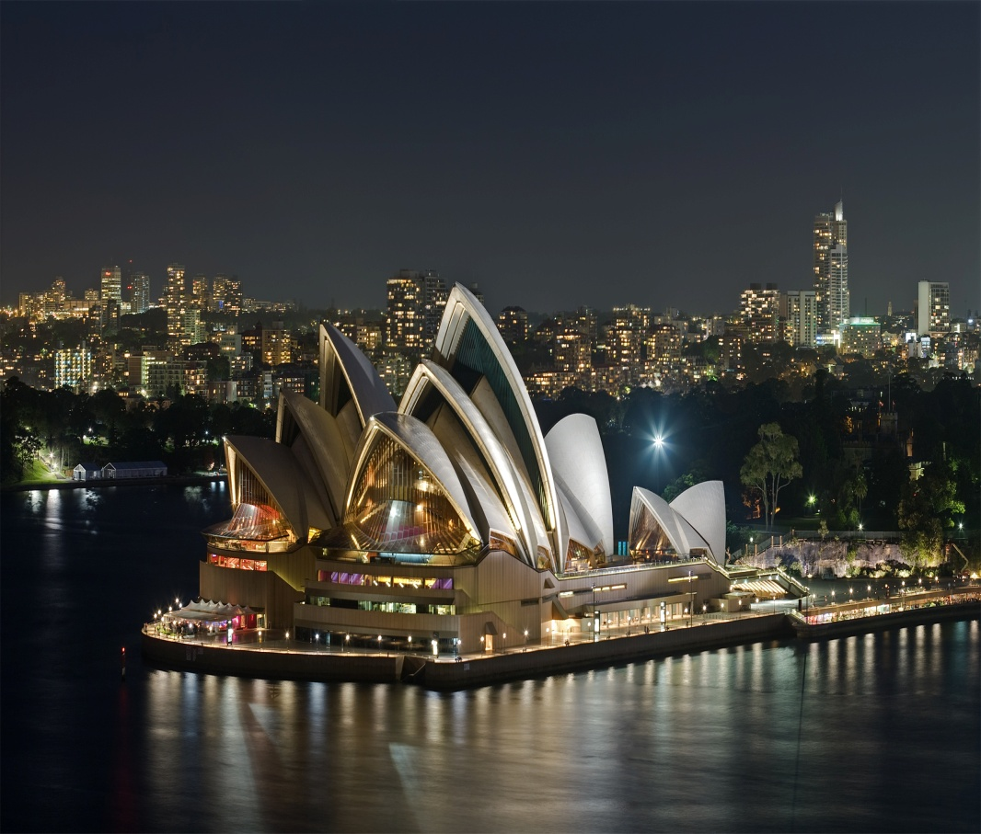
Sydney Opera House

Slide 10
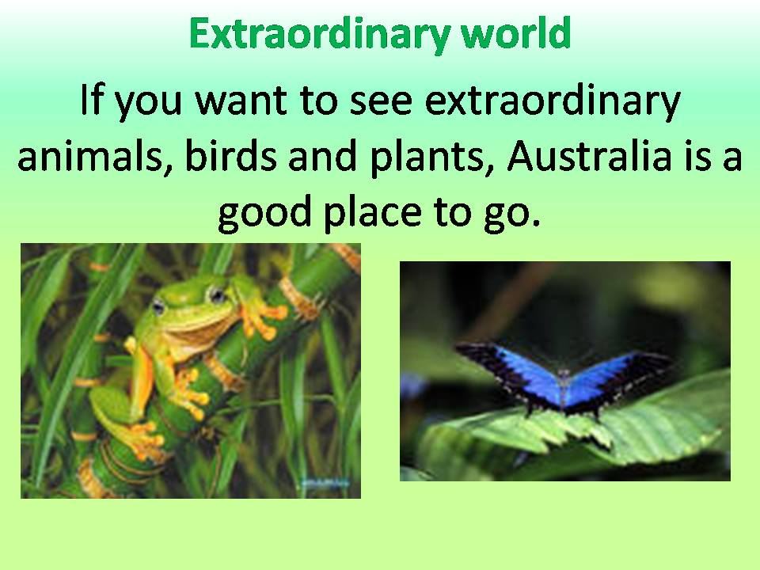

Slide 11
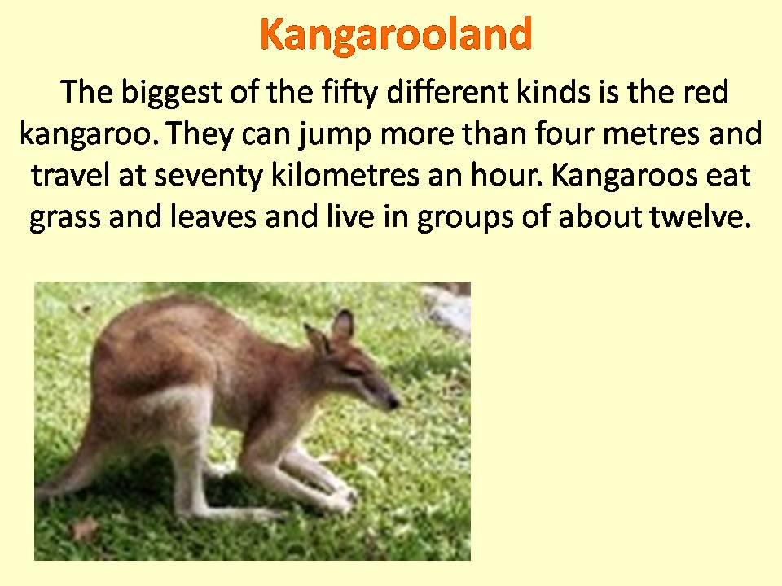

Slide 12
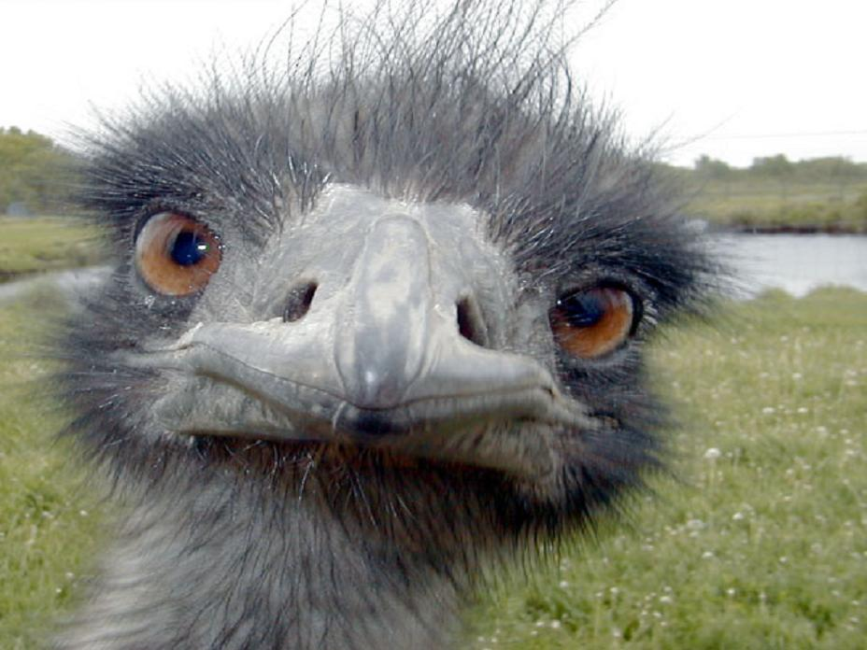
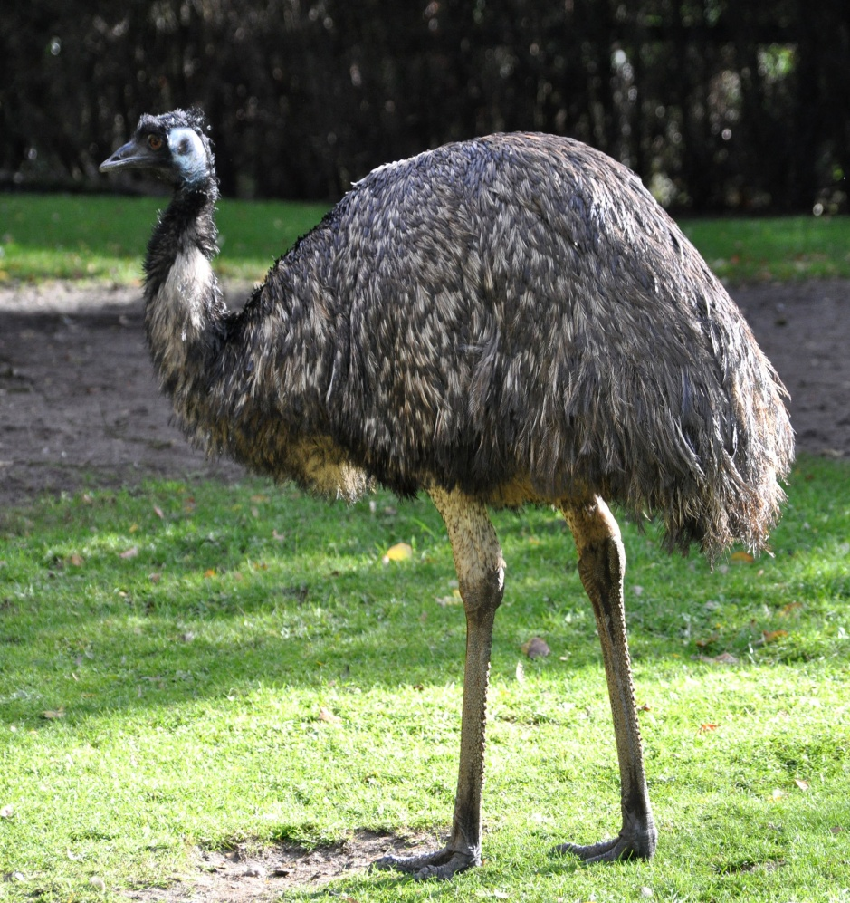
The emu is the largest Australian bird which cannot fly but runs well. The emu and the kangaroo are represented on the national emblem of Australia.

Slide 13
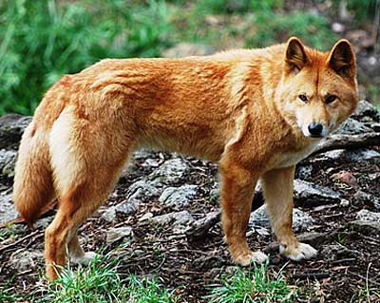
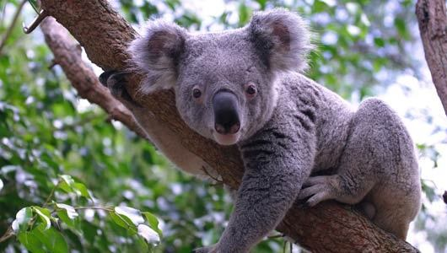
dingo or wild dog koala bear

Slide 14
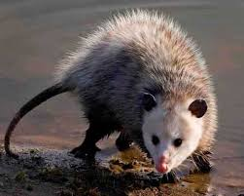
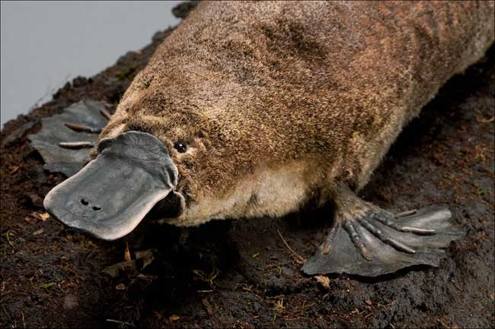
Possum
Platypus

Slide 15

Test
Australia is situated in the southwest of the …
Atlantic Ocean
Pacific Ocean
c. Indian Ocean

Slide 16
Test
2. It is washed by …
a. the Pacific Ocean and the Indian Ocean
b. the Atlantic Ocean and the Indian Ocean
c. the Pacific Ocean and the Atlantic Ocean

Slide 17
Test
3. The federal capital of the country is …
Sydney
Canberra
Melbourne

Slide 18
Test
4. The official language of the country is ….
a. French
b. Australian
c. English

Slide 19
Test
5. Australia’s climate is relatively …
a. warm and wet
b. dry and warm
c. dry and cool

Slide 20
Test
6. Australia is situated in the … hemisphere.
south
northern
western

Slide 21
Test
7. Winter in Australia is from … to ….
a. December … February
b. March … May
c. June … August

Slide 22
Test
8. Spring in Australia is from … to …
June … August
September … November
March … May

Slide 23
Test
9. … are represented on the national emblem of Australia.
a. The emu and the kangaroo
b. The koala bear and the emu
c. The possum and the dingo

Slide 24
Test
10. Australia has winter when we have …
a. autumn
b. spring
c. summer

Slide 25
Test
11. The emu is the largest bird which
a. can fly and runs well
b. cannot fly but runs well
c. cannot run well but flies well

Slide 26
Test
12. Australia includes …
a. 5 states and 2 territories
b. 6 states and 2 territories
c. 6 states and 3 territories

