Slide 1

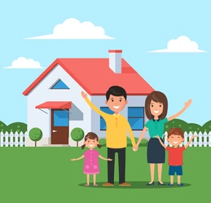
My family at home

Slide 2
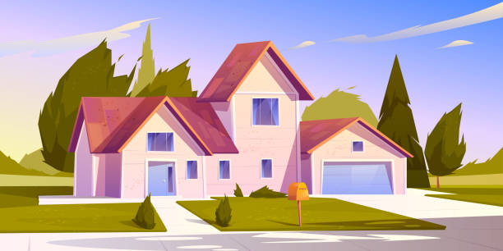
My family lives in a small house. It's simple but pretty.

Slide 3
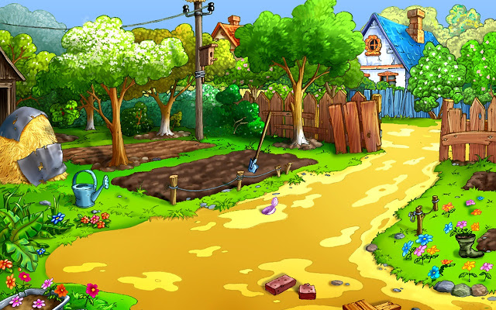
It has a large garden. I like to work in the garden but my sister hates to work in the garden.

Slide 4

She prefers to read. She reads in the morning, in the afternoon and at night.

Slide 5
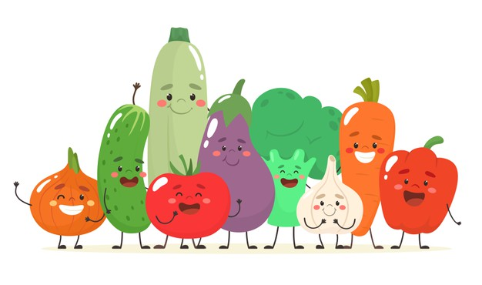
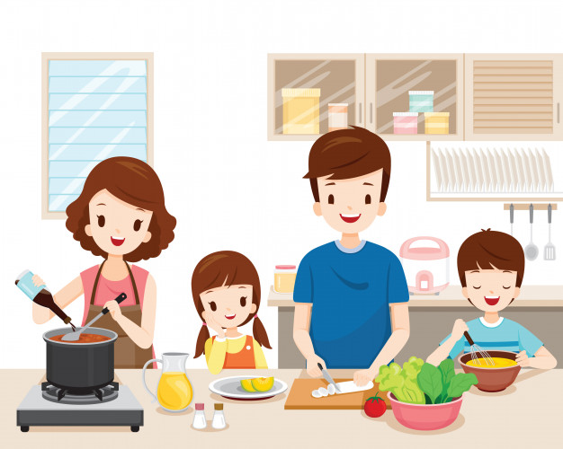
I give all of the vegetables to mom and dad. They like to cook in our small kitchen. I eat any vegetable but my sister eats only a few.

Slide 6
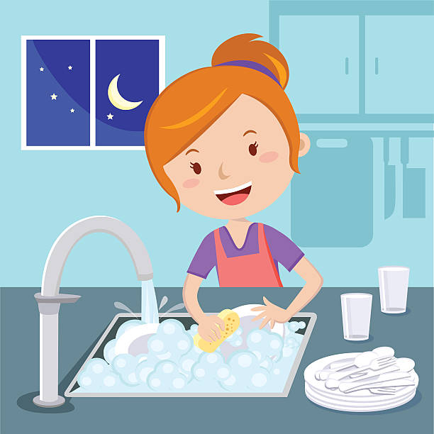
My family always eats breakfast and dinner together. We talk. We laugh. Then my sister washes the dishes.

Slide 7



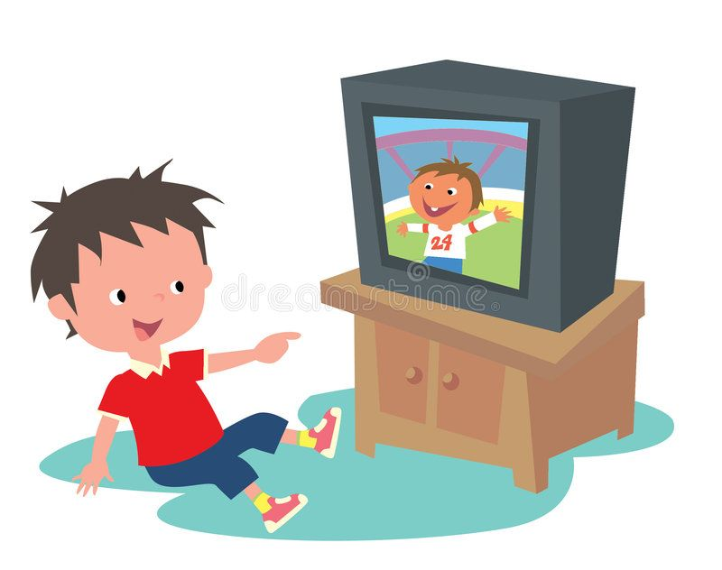
At night dad likes to listen to music. Mom works on the computer. I watch television. And my sister reads.

Slide 8
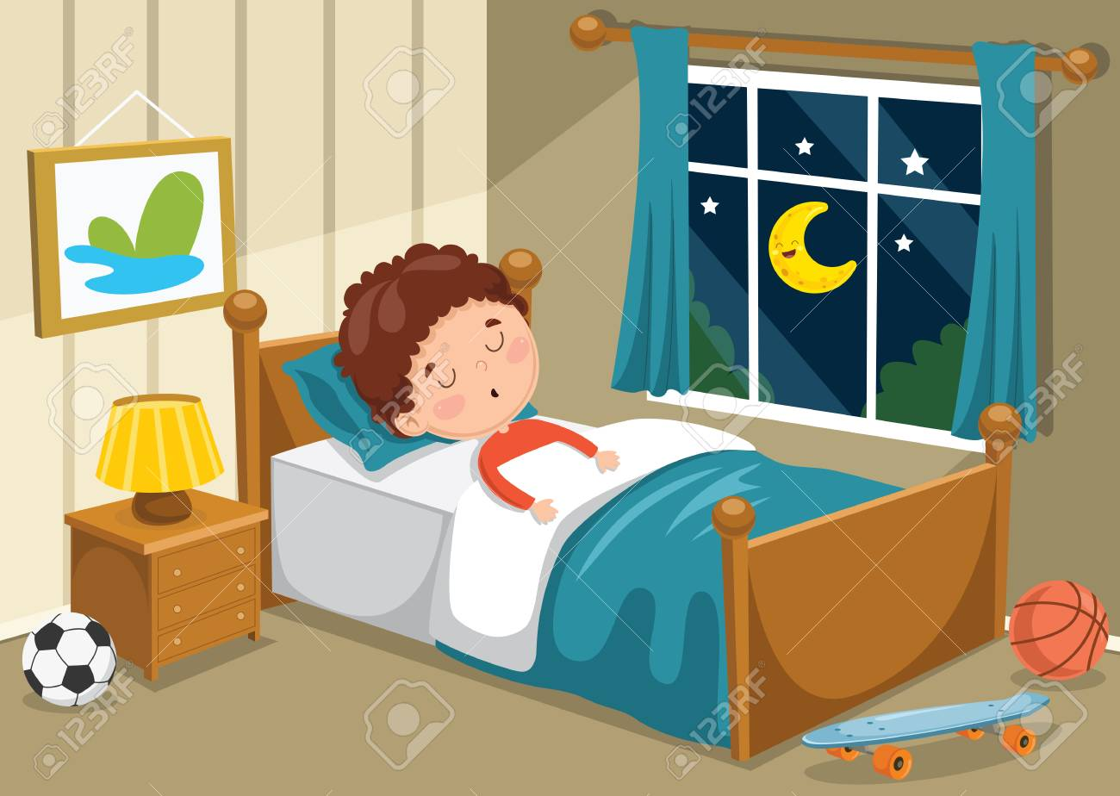
Soon we go to bed. My parents go to bed late but my sister and I go to bed early. I'm ready to go to sleep but my sister wants to keep reading.

Slide 9
Great!

