Slide 1
Module 1. Who are you?
Where are you from?

Slide 2
I’m from Ukraine.
I’m Ukrainian.
Where are you from?

Slide 3
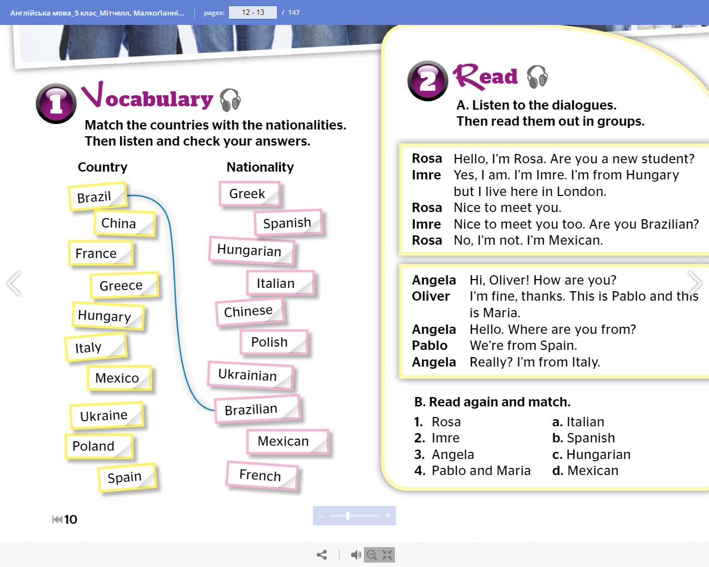


Slide 4
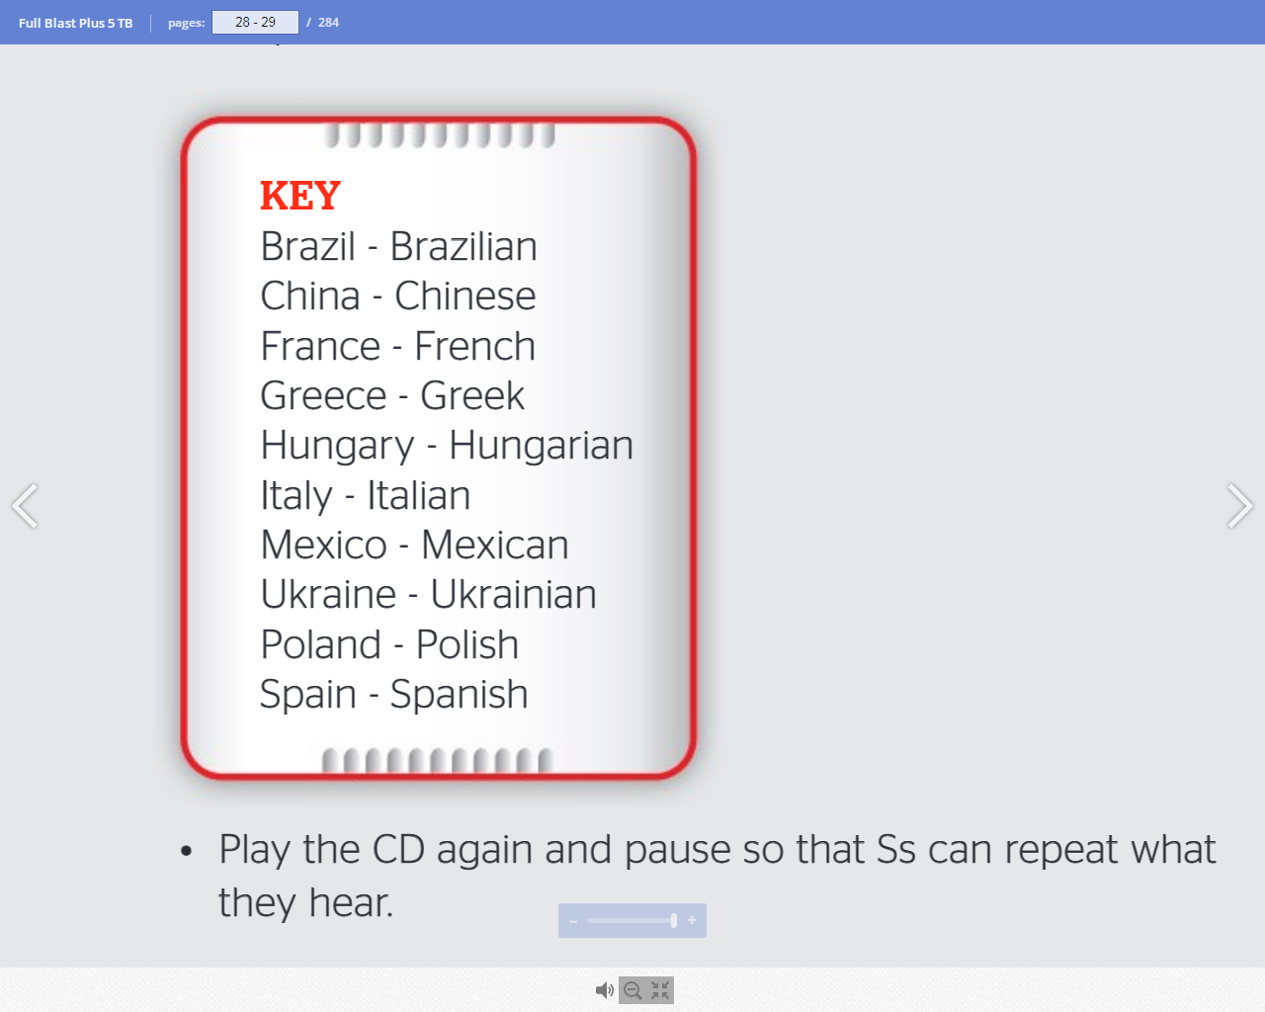

Slide 5
Choose a country from the list and imagine that you come form this country. Talk in pairs.
- I’m from … . I’m … . Where are you from?
- I’m from … . I’m … .

Slide 6
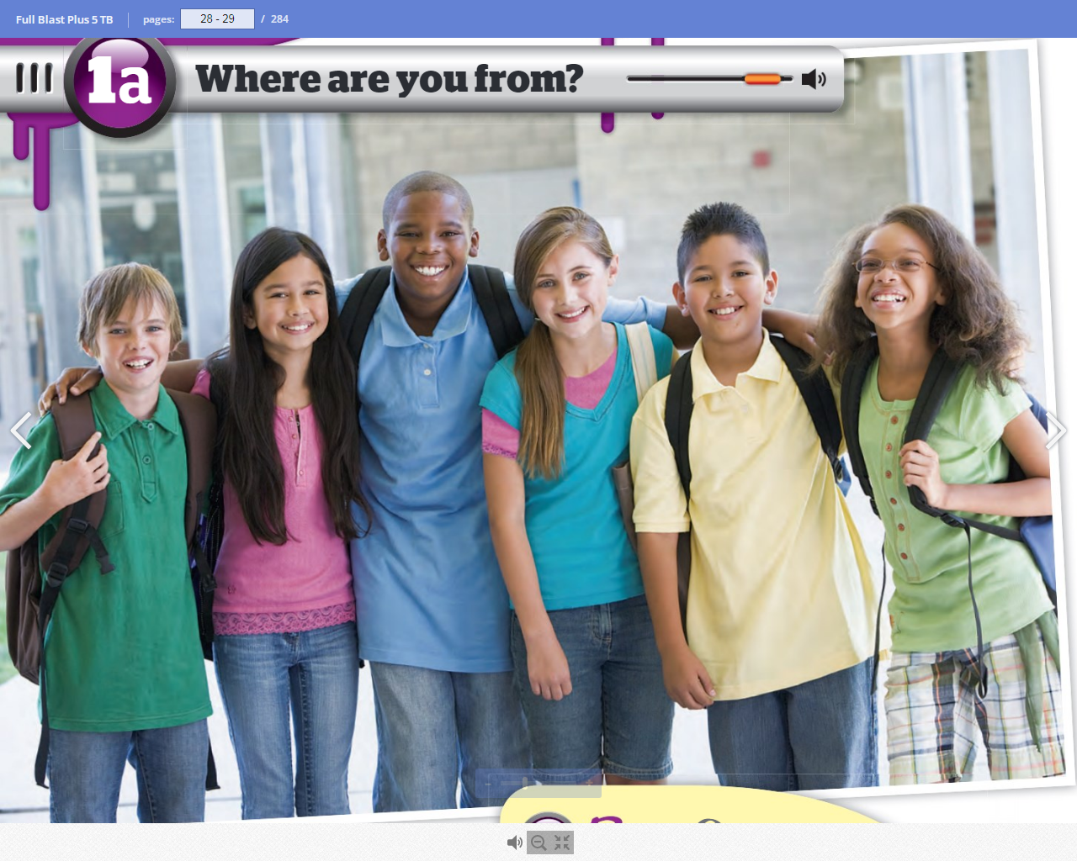

Slide 7
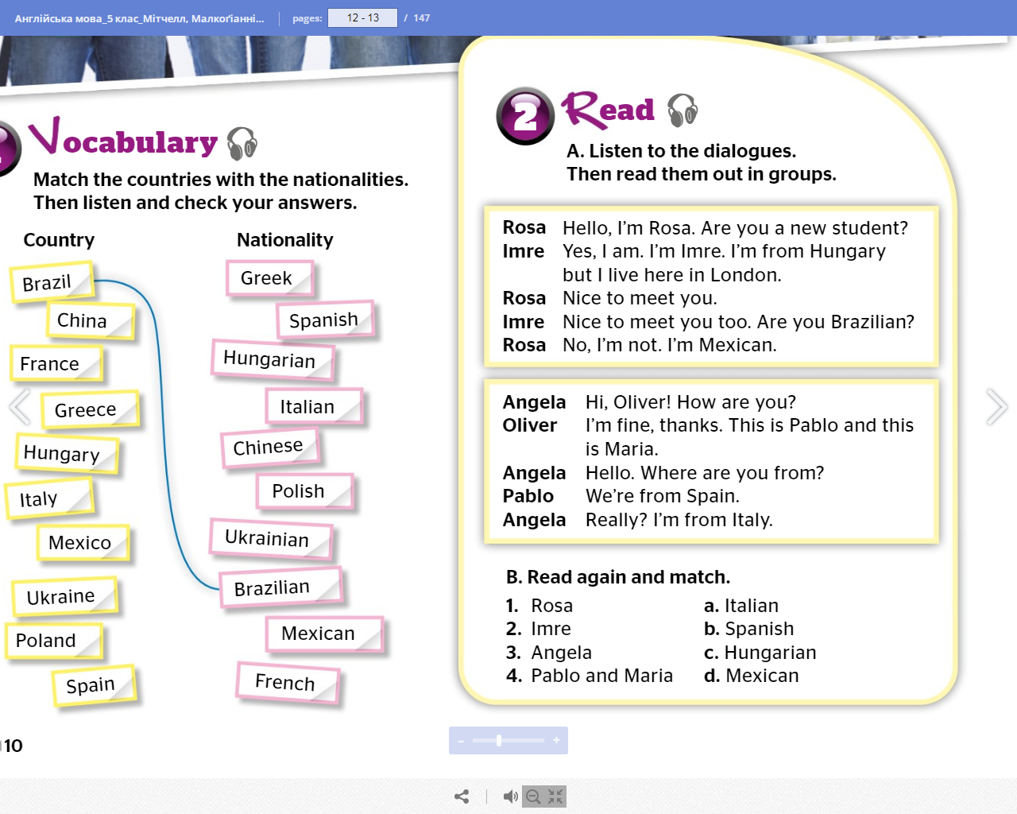

Slide 8
Where is Imre from?
Where is Rose from?
Where is Oliver from?
Where are Pablo and Maria from?

Slide 9
Nice to meet you. (when we meet someone for the first time)
This is … . (when we want to introduce someone to someone else)

Slide 11
